Slide 1


GYM MANAGEMENT SYSTEM

Slide 2
Group members
Anistina Dsouza
22-CS-004
GYM
MANAGEMENT
SYSTEM
Prathana Dubey
22-CS-005
Vishwaskumar Rami
22-CS-024
Internal Guide
Prof. Ashwini Kshatriya
External Guide
Ms. Daxa Ravani

Slide 3


Contents
About the Company | 04
Introductions | 05
Proposed System | 06
Tools and Technologies | 09
HomePage | 10
Registration | 15
Forgot Password | 21
Gym Member Panel | 29
Trainer Panel | 60
Admin Panel | 79
Reports | 115
Bibilography | 136
Login | 18

Slide 4

About the Company
TEJEEL
INNOVATIONS
CW-A61,
2nd floor, I-Hub,
KCG Campus, opp. PRL,
Navrangpura,
Ahmedabad,
Gujarat-380015
TEJEEL INNOVATIONS LLP, established in 2021, is driven by a bold vision to address social challenges using innovative methods and cutting-edge AI technologies.
Our dynamic team brings extensive knowledge and expertise in AI to develop impactful solutions that make a positive difference in society. We are committed to leveraging the power of AI only when necessary, employing it as a tool to enhance our problem-solving capabilities.
Our approach is rooted in a deep commitment to ethical and responsible use of AI, ensuring that our solutions are aligned with societal values and needs. With a passion for innovation, we strive to create meaningful and sustainable impact in the world.
Contact :- +917046106845
Contact Mail id: tejeelinnovationsllp@gmail.com :

Slide 5

INTRODUCTION
In today's health-conscious world, gyms face the challenge of managing memberships, appointments and keeping their members engaged. This is where gym management systems come in.
A gym management system, is a digital tool that helps gyms
It acts like a central hub for all things gym-related, automating tasks and providing a platform for staff and gym members.
streamline operations
improve member experience
gain valuable insights.

Slide 6
Our gym management system has 4 types of users having following roles:
•Admin : Admin can login, membership plans, view payment and view feedback.
•
•Trainer : Trainer can login, edit his/her profile, view feedback , create and assign workout plans.
•Gym member : Client can login, edit his/her profile, purchase membership plans, make payments, post feedbacks.
•Visitor : Visitor can register.
Proposed System

Slide 7
Dashboard: here the personal information will be provided to user on his/her personal Dashboard.
Proposed System cont..

Slide 8
Feedback: Allows user to provide feedback on trainer regarding workout plans and personal opinions
Workout plan: The trainer will provide work out plans to the members assigned under him.
Proposed System cont..

Slide 9
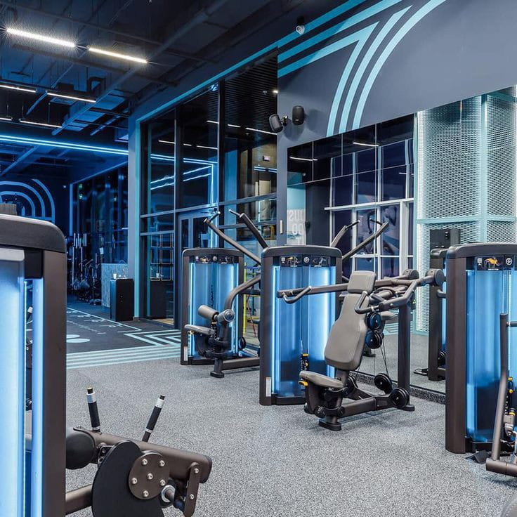







Tools And
Technology
FRONT-END
BACK-END
HTML
CSS
JavaScript
ReactJS
Node.js
Mongo DB
DFD
Draw.io

Slide 10

Home page
The landing page for anyone who will visit our Website.

Slide 11
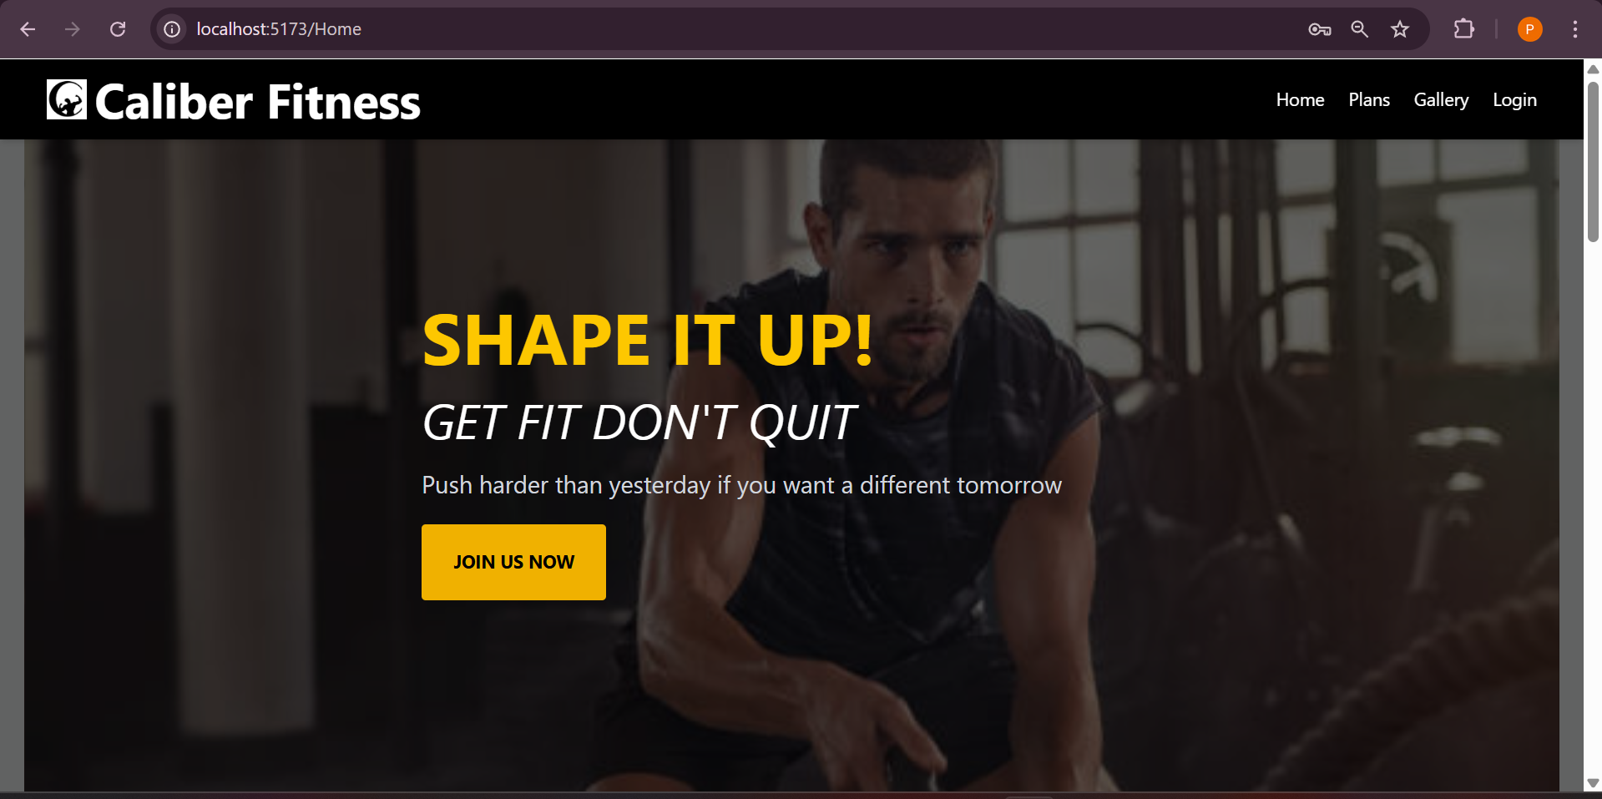

Slide 12
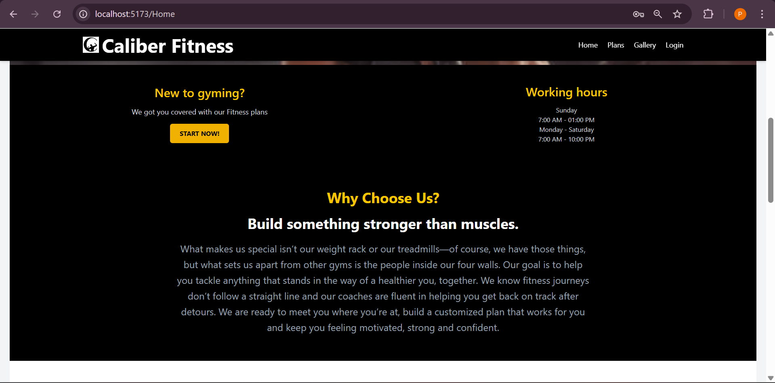

Slide 13
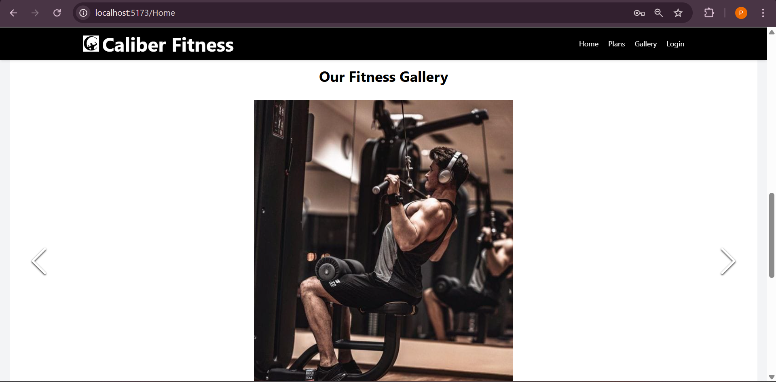

Slide 14
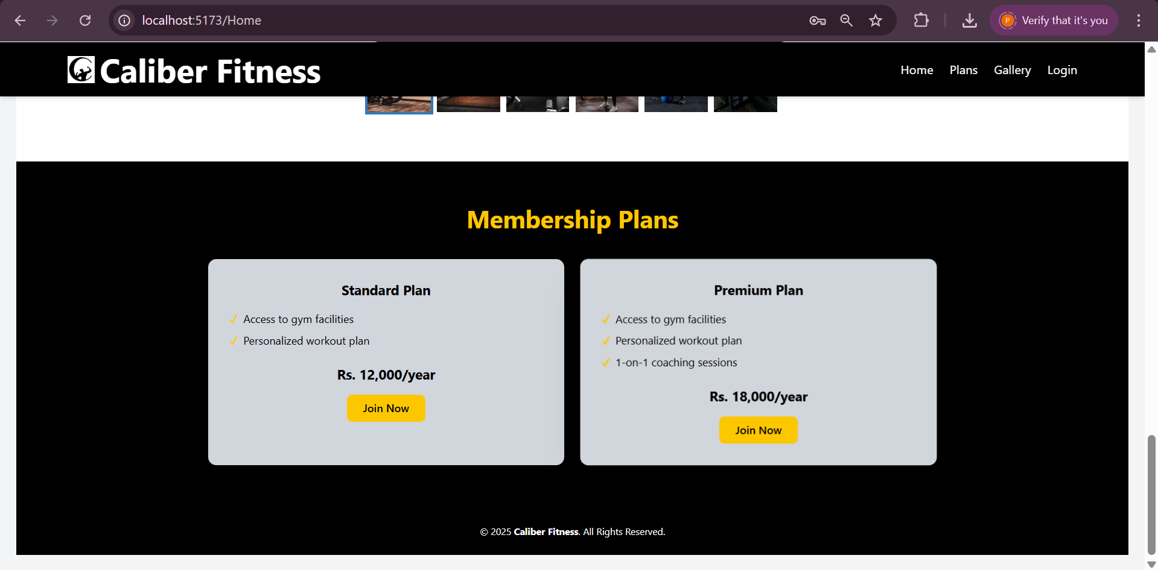
These are the membership plans for our Gym ‘Caliber Fitness’ !.. If the Visitor is interested to be the member for our Gym he/she is required to buy a membership plan .

Slide 15
Registration
User can register to their account.

Slide 16
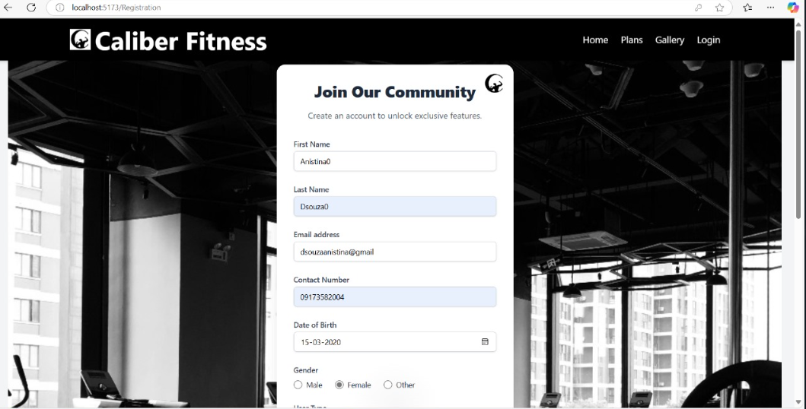
This is the Registration Page for visitor to register himself/herself to start with use of further payment and profile features of our Gym.

Slide 17
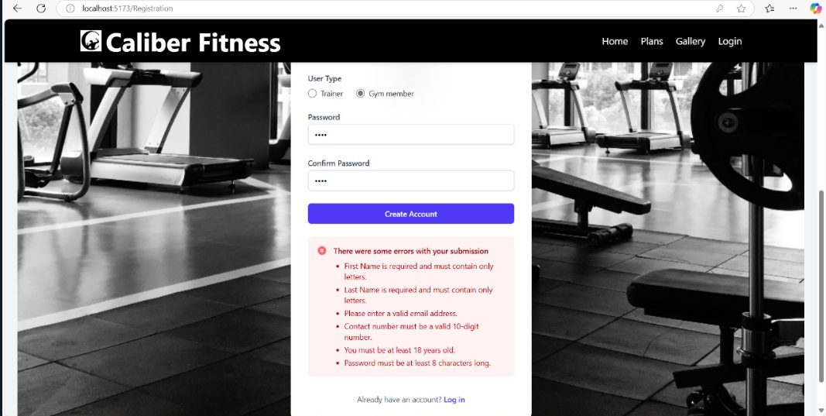
If the visitor enters the invalid data for the registration page , he/she will be restricted from submitting the registration form.

Slide 18
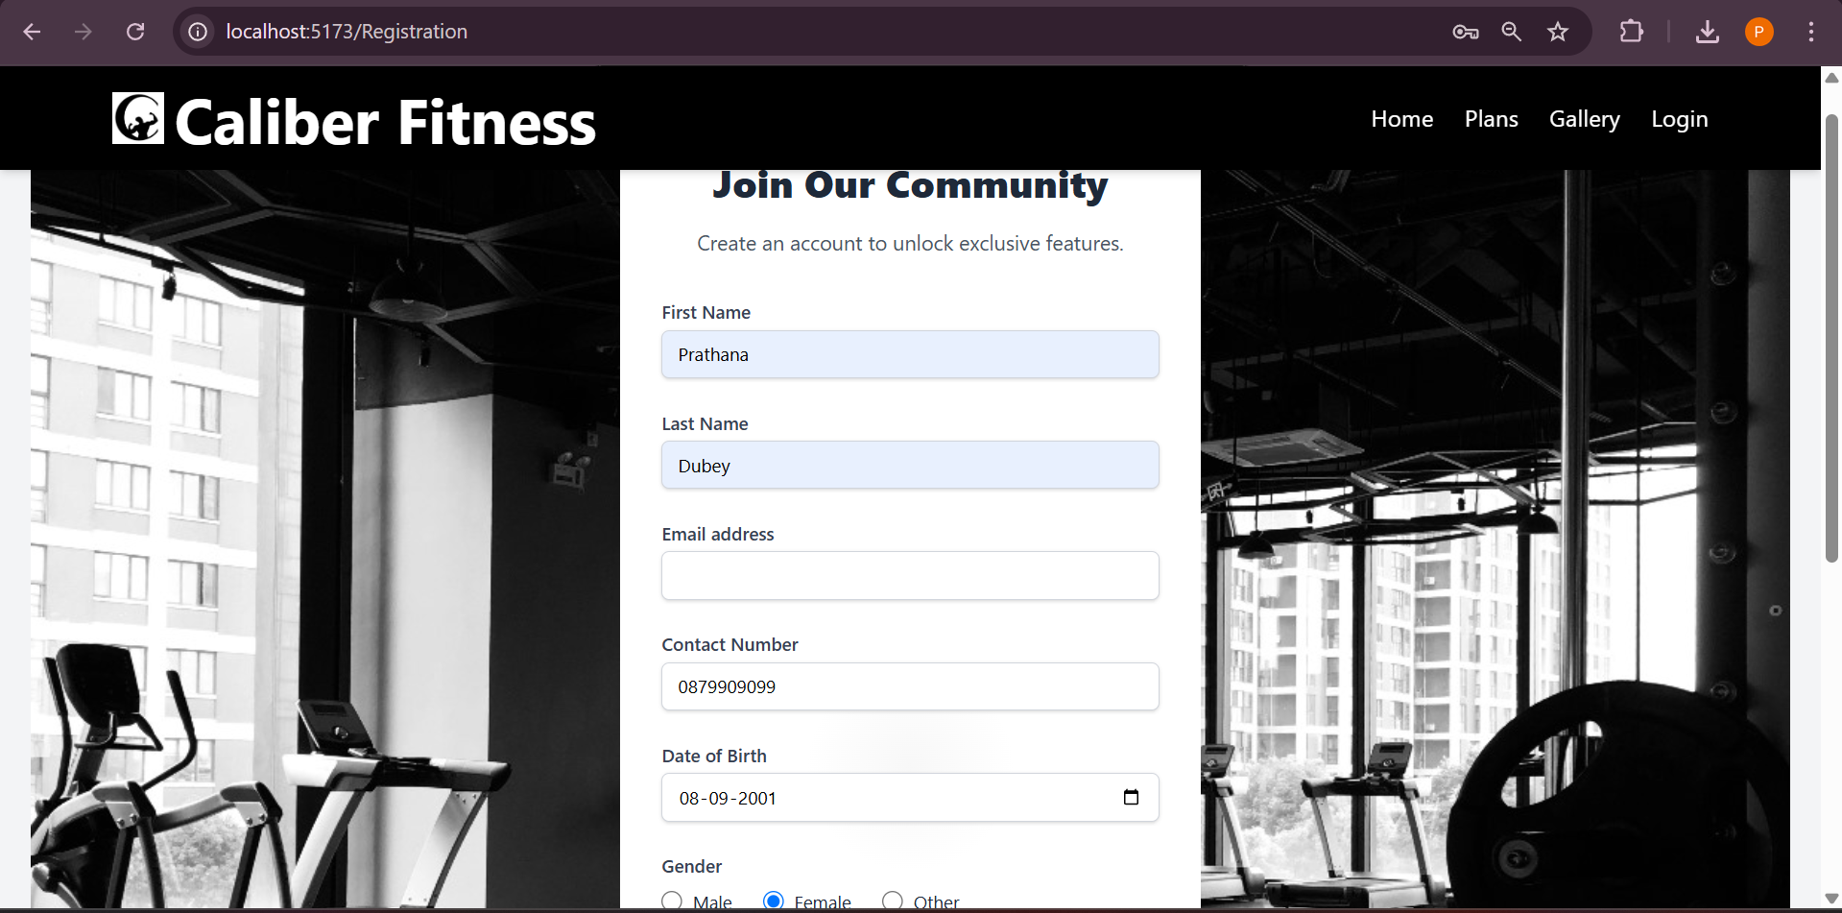

Slide 19
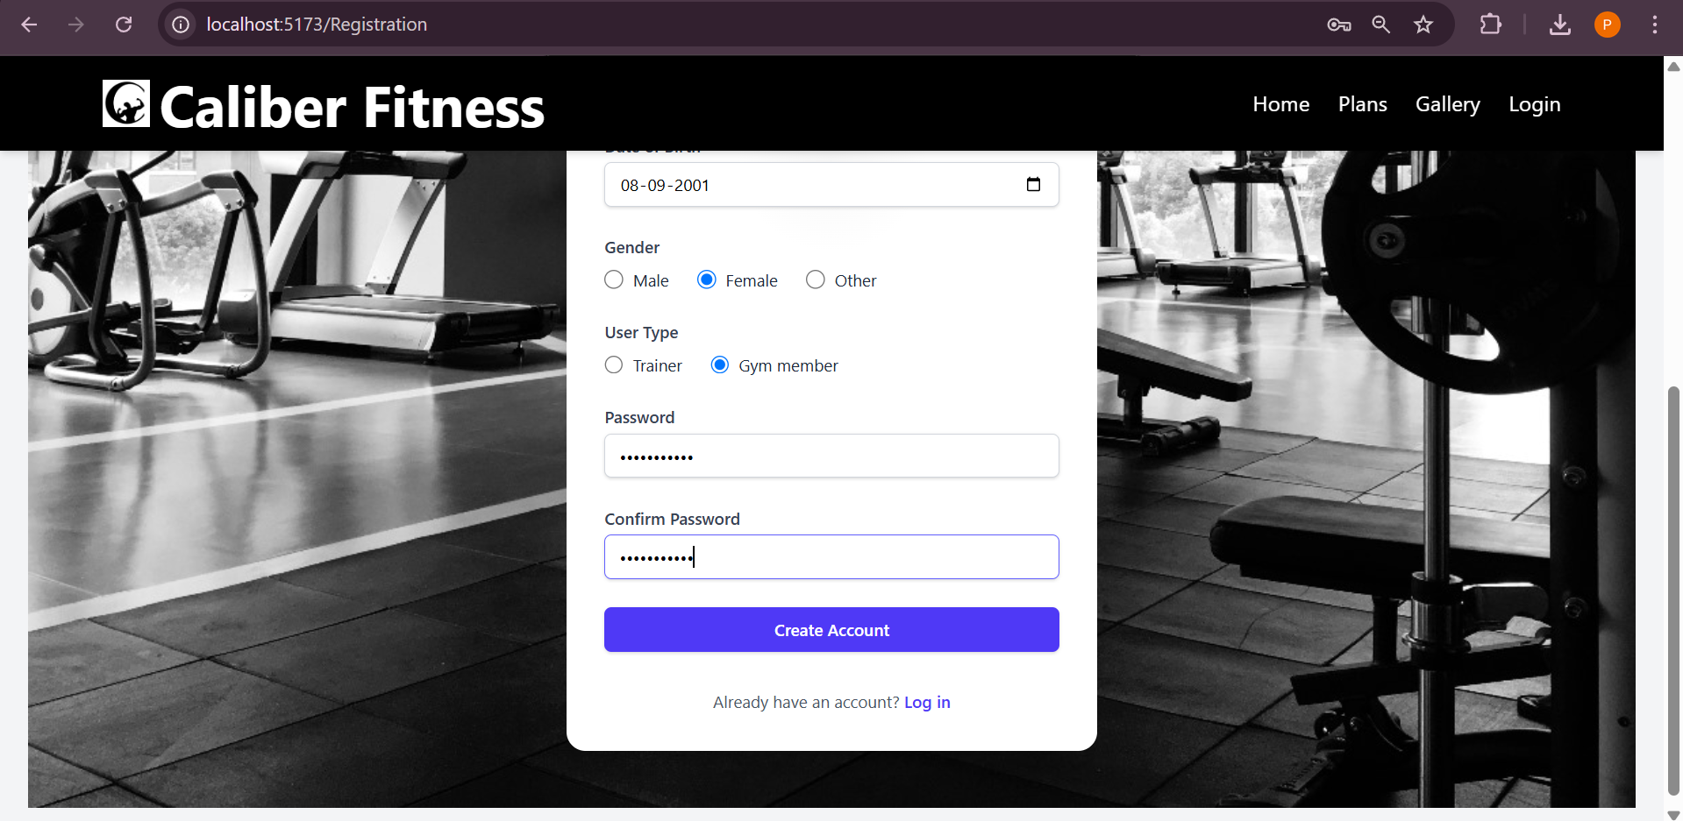

Slide 20
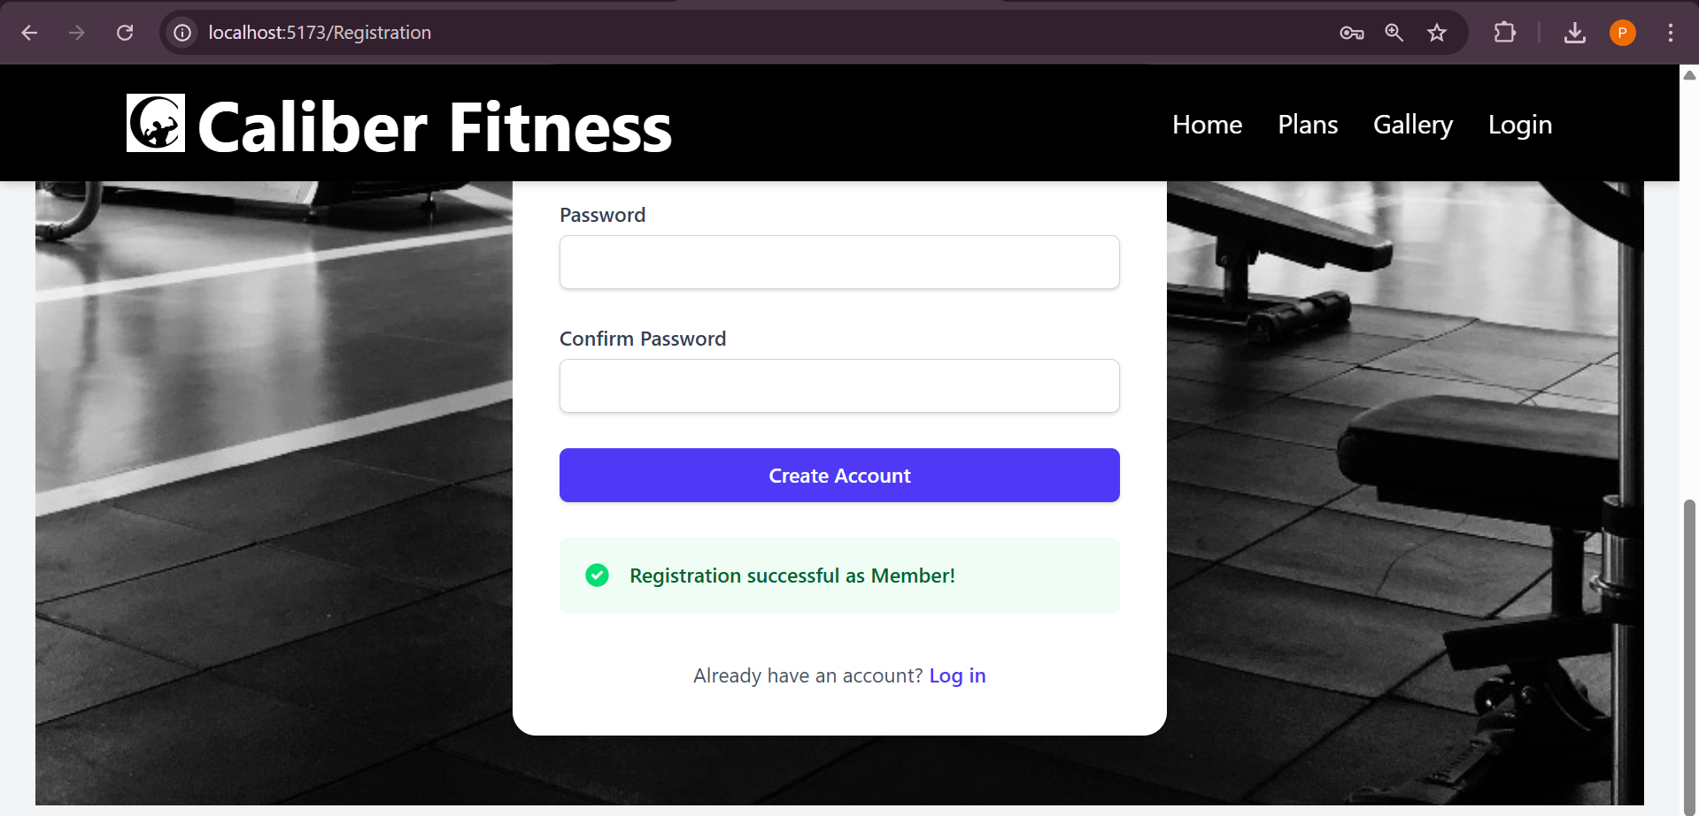

Slide 21
Login
User can login to his account.

Slide 22
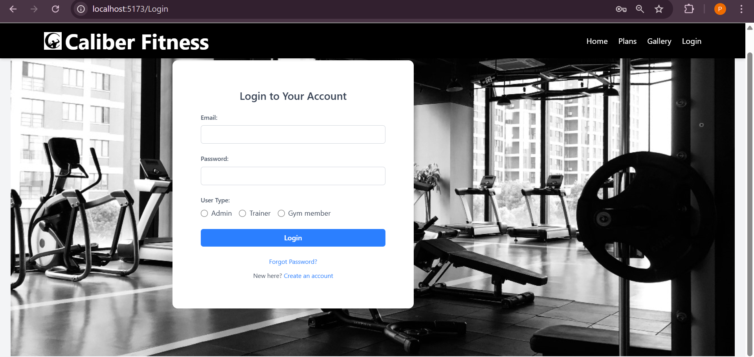
login validation

Slide 23
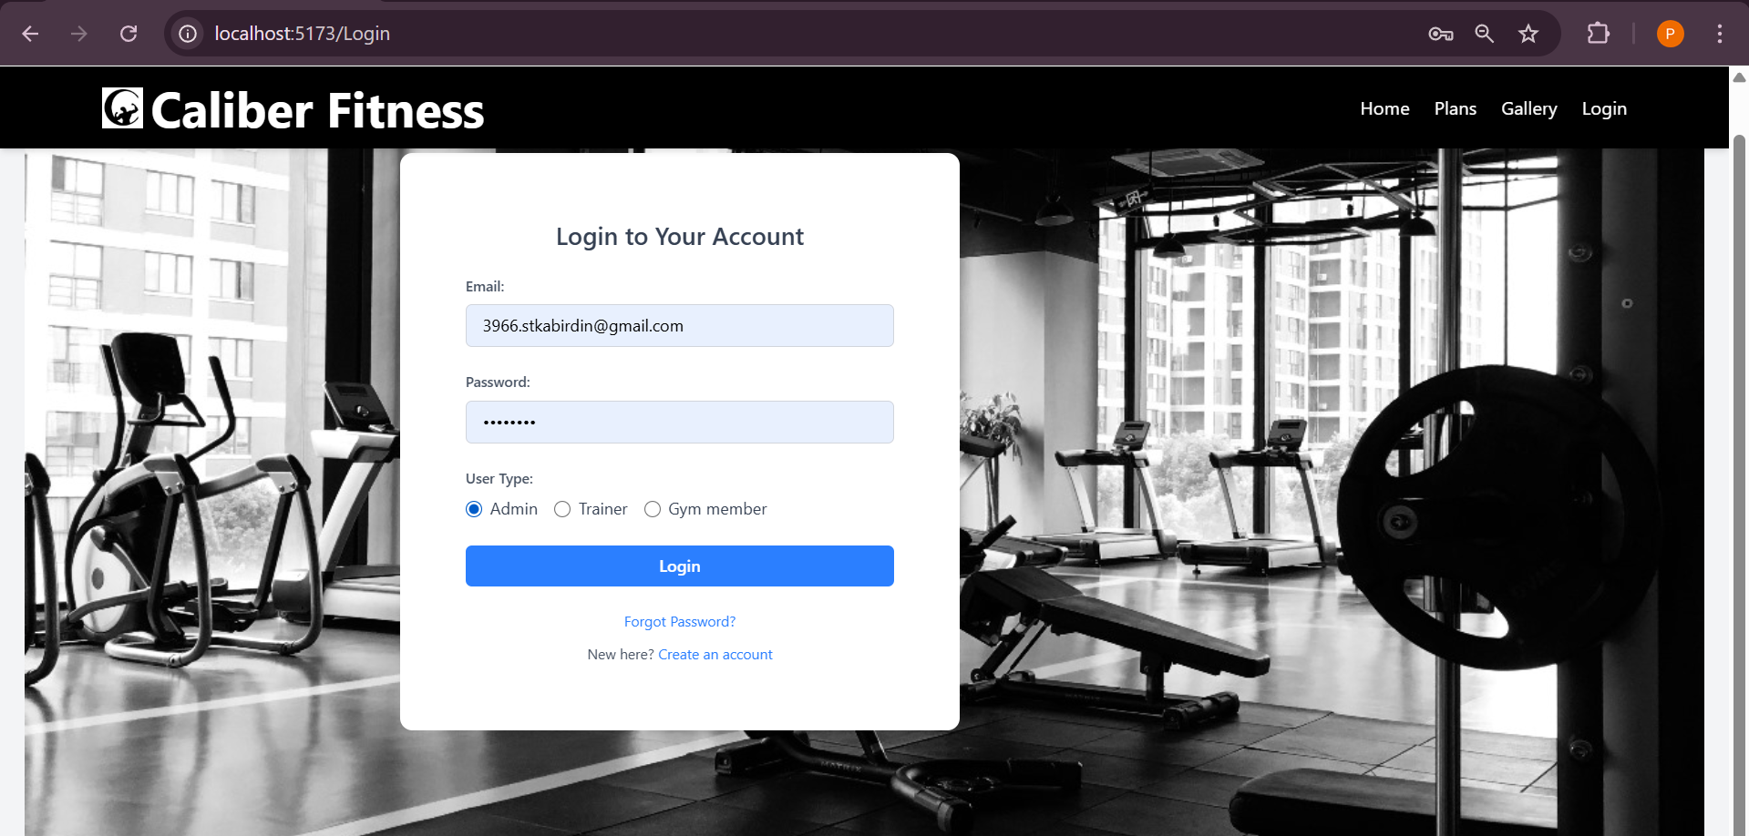

Slide 24
Forgot Password
User can change the Password in case he/she forgots it.

Slide 25
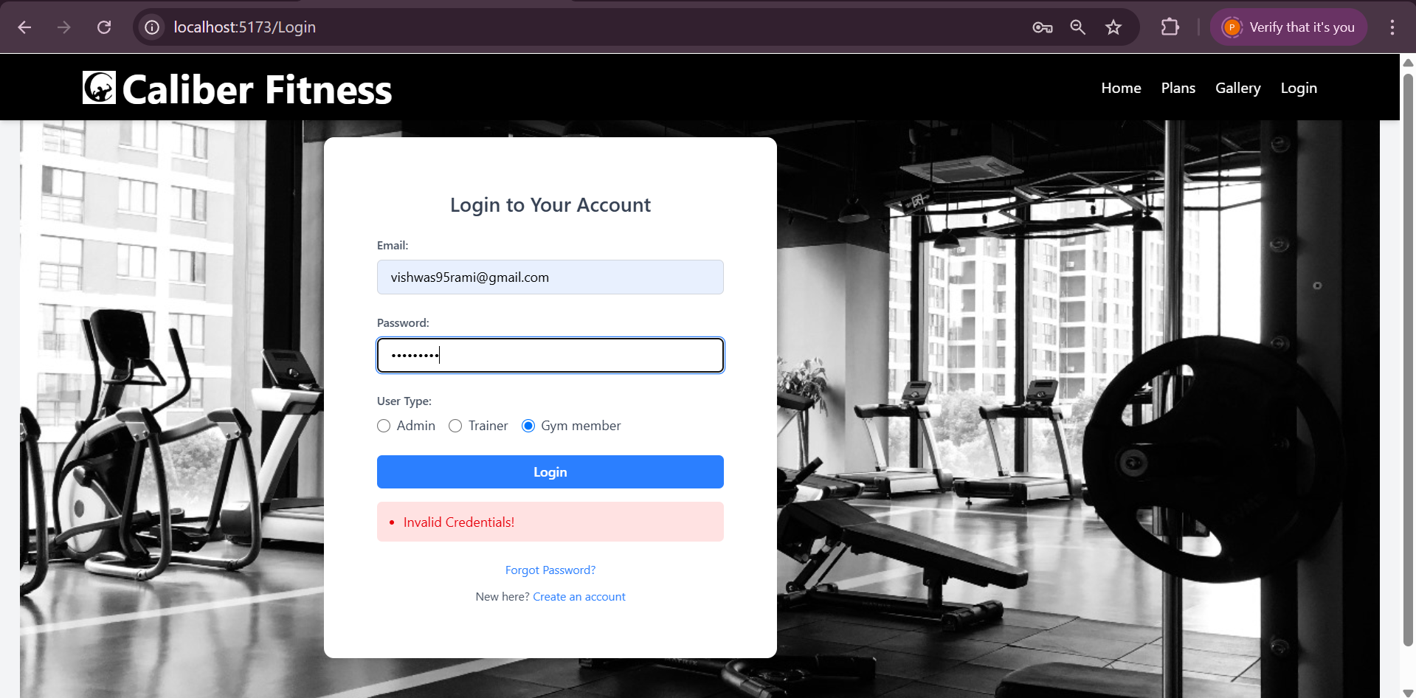

Slide 26
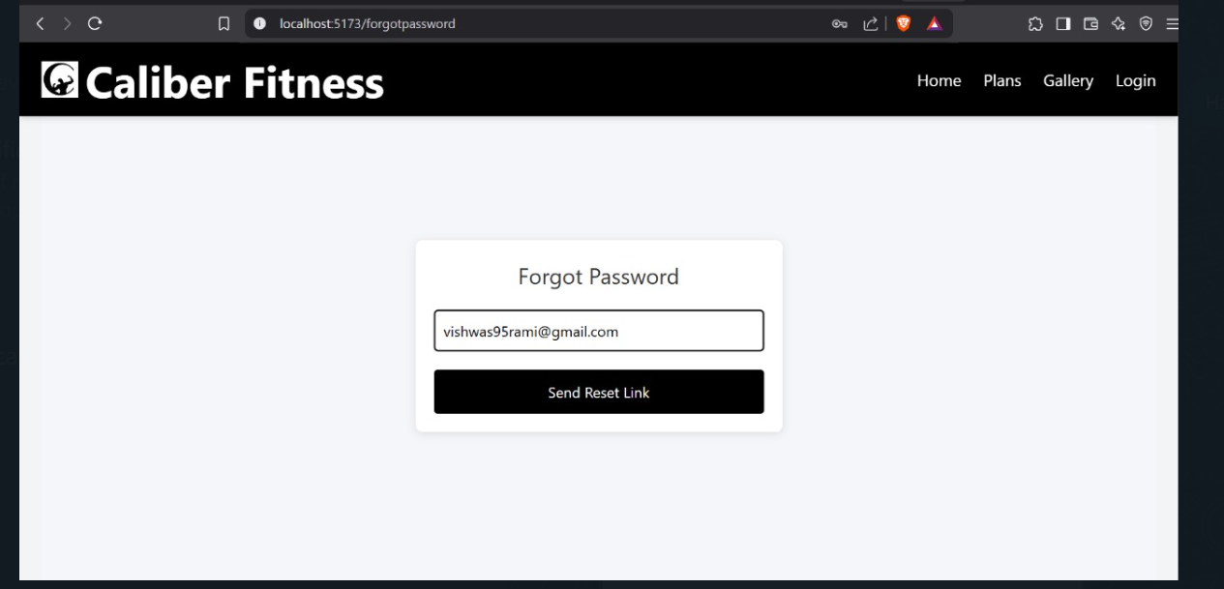

Slide 27
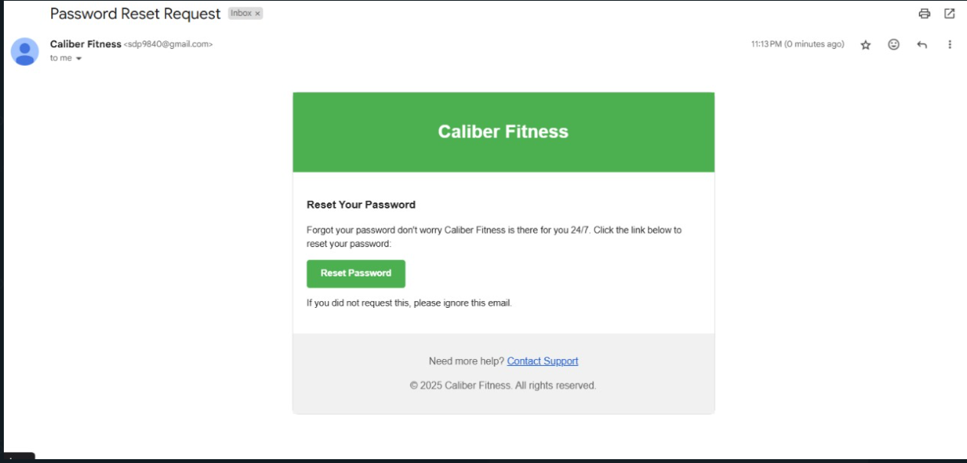

Slide 28
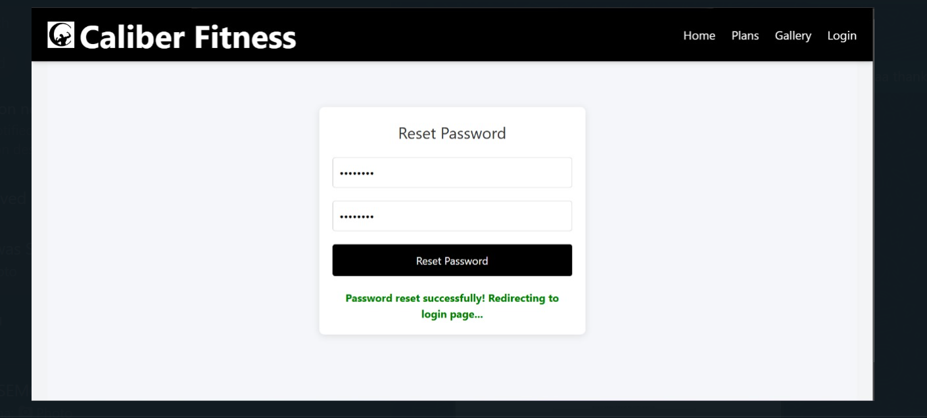

Slide 29

Gym member Panel

Slide 30
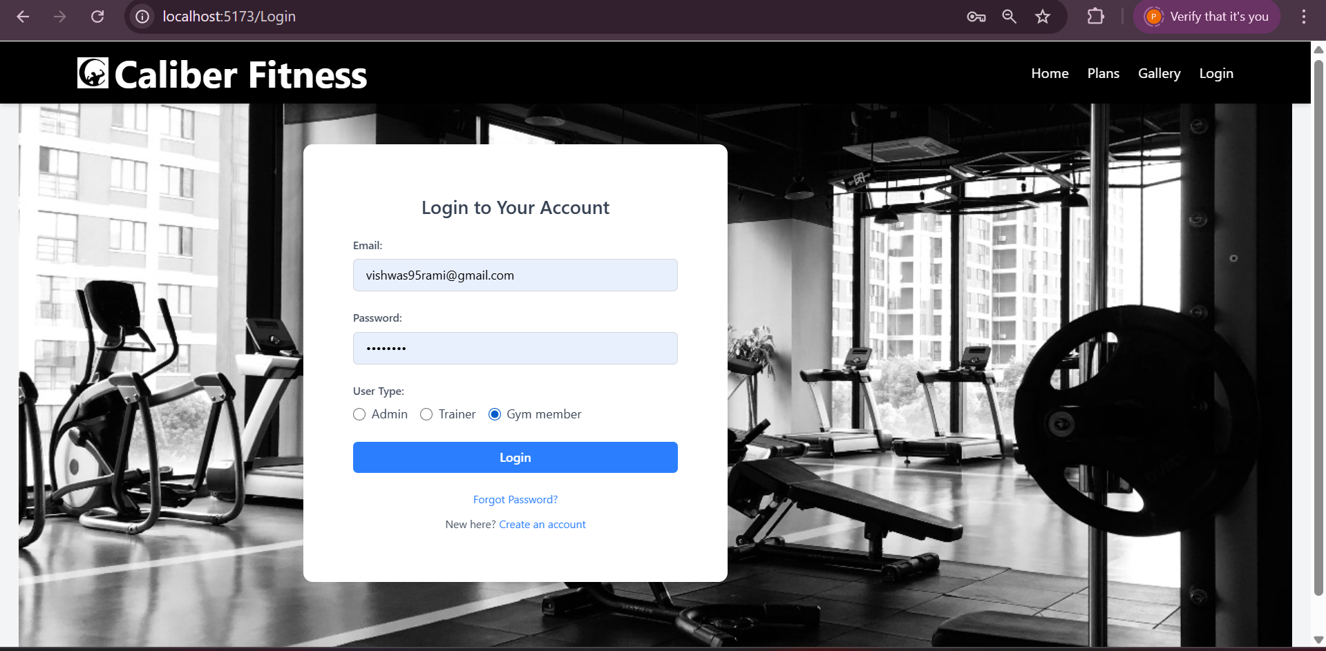

Slide 31
Member Dashboard

Slide 32
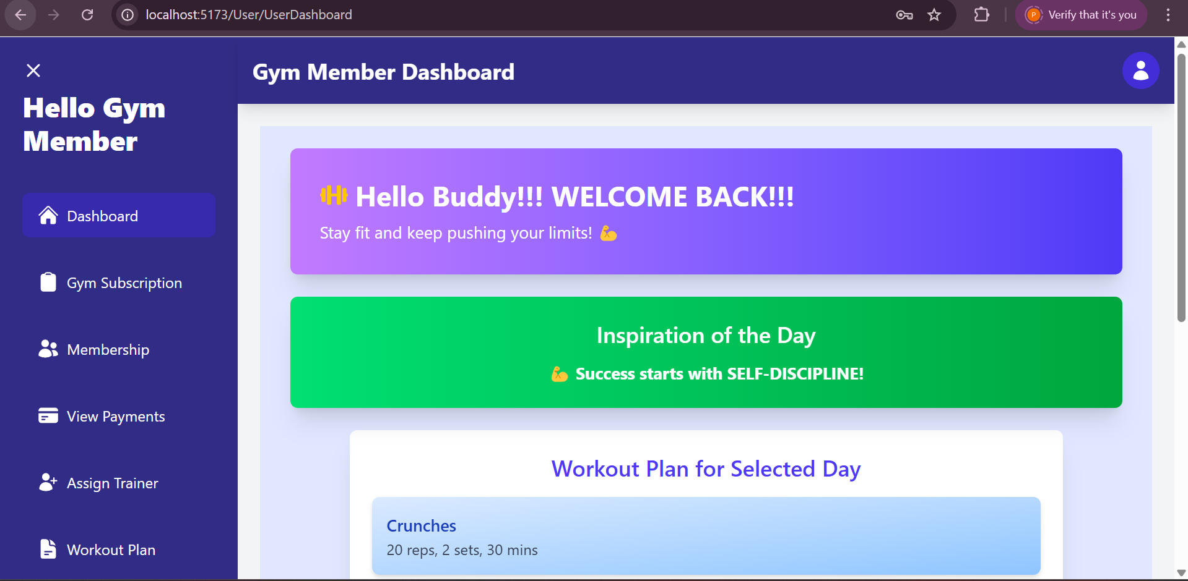
Member Dashboard
From here the member can view subscription plan ,membership,payments,assigend trainer,workout plan and can provide feedback.

Slide 33
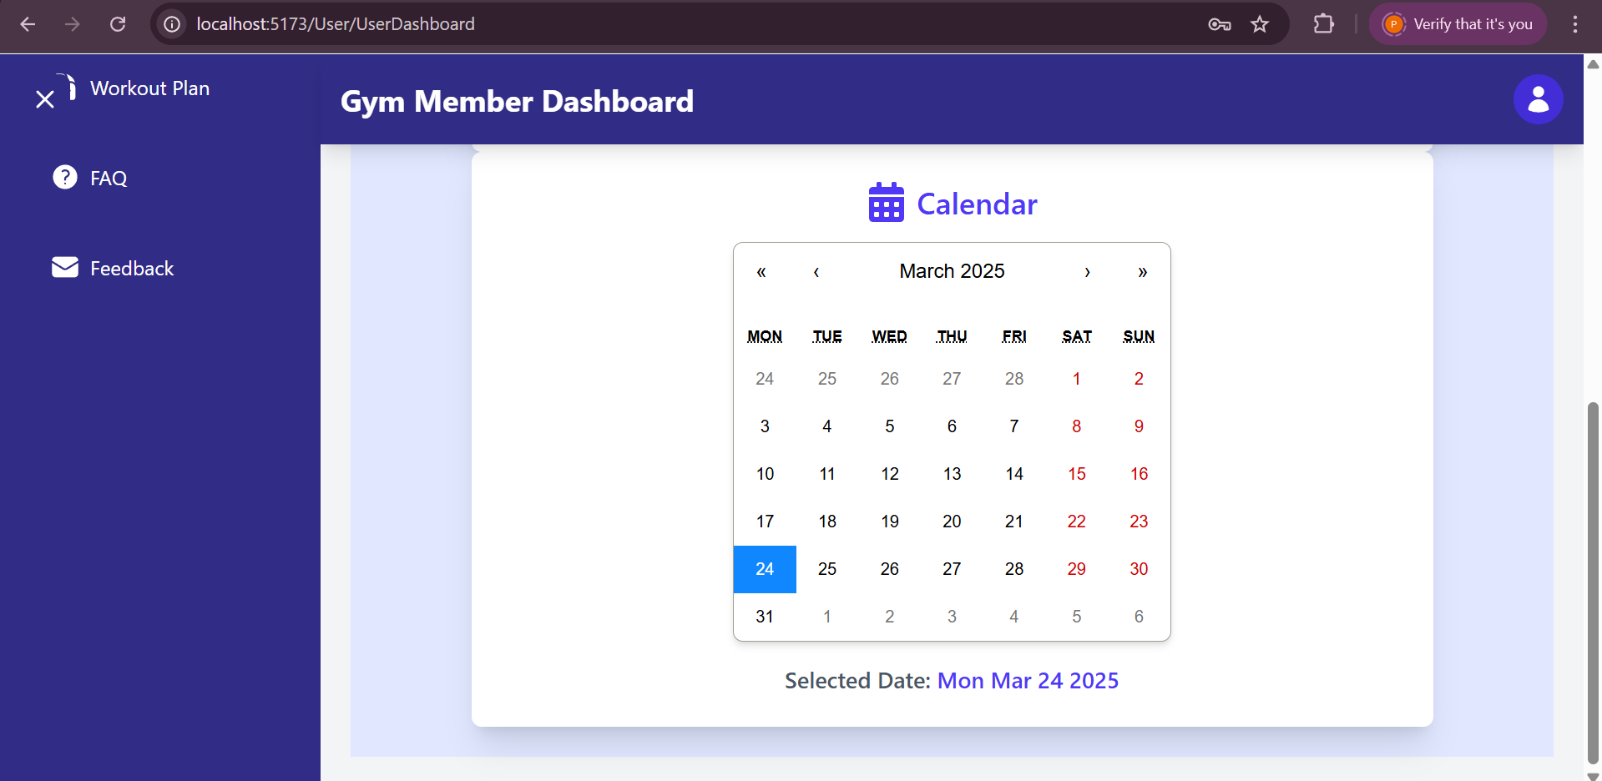

Slide 34
Member Profile

Slide 35
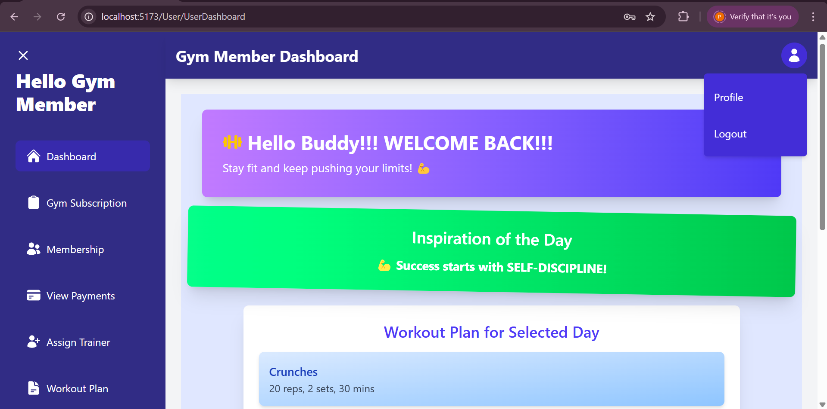
Member Profile

Slide 36
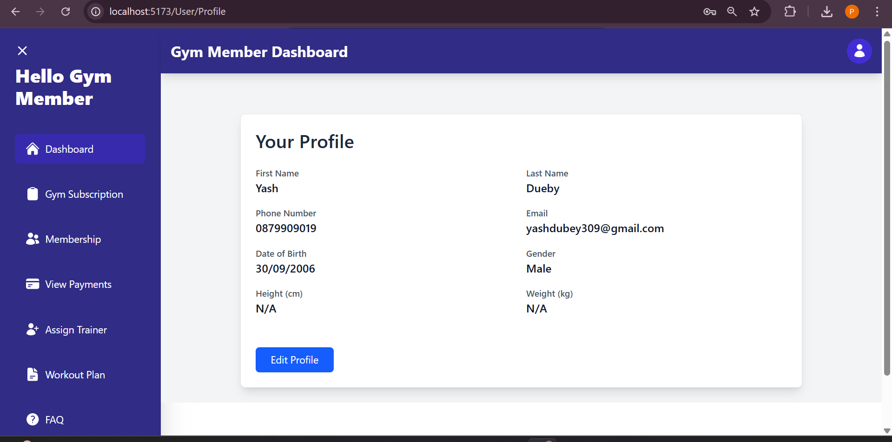

Slide 37
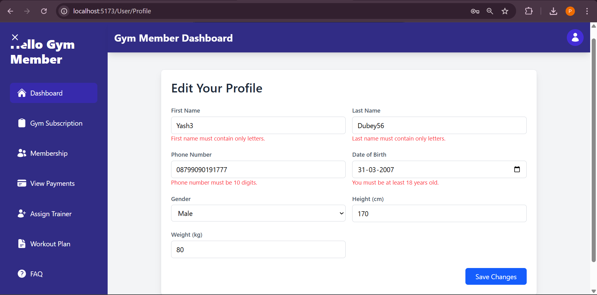
Validation for Profile Updating Form!!!

Slide 38
Member Subscription

Slide 39
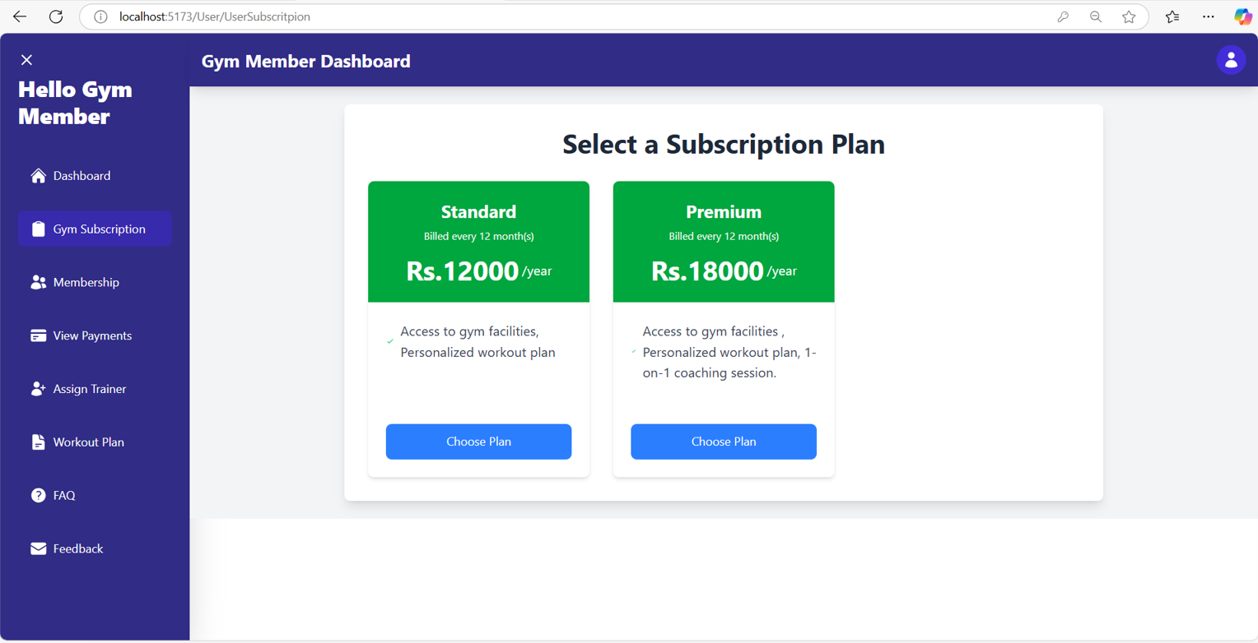
Subscription Plan
If the member wants to update his/her existing plan… He/she can buy new plan by clicking on CHOOSE PLAN in subscription tabs.

Slide 40
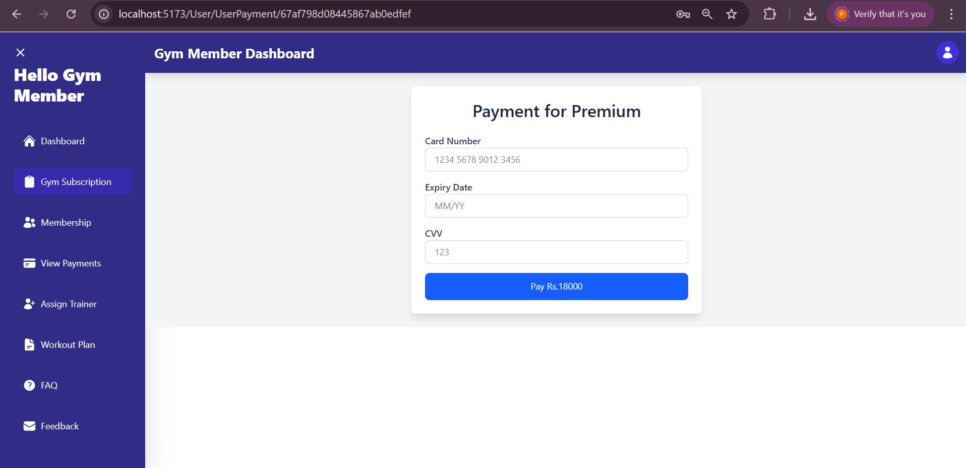
By clicking on CHOOSE PLAN a new tab will open for payment of that selected plan !!

Slide 41
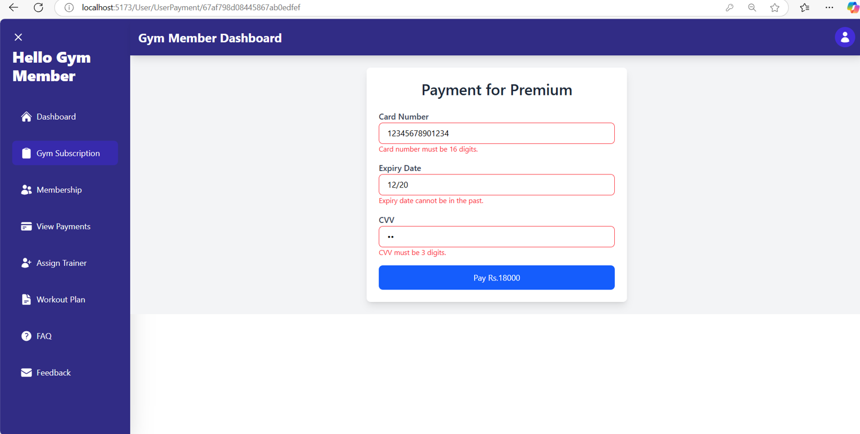
Validation for Payment Form!!!

Slide 42
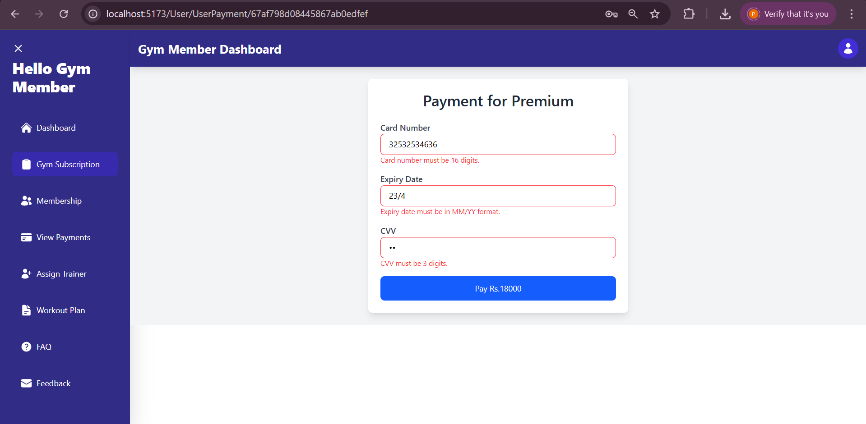

Slide 43
Membership

Slide 44
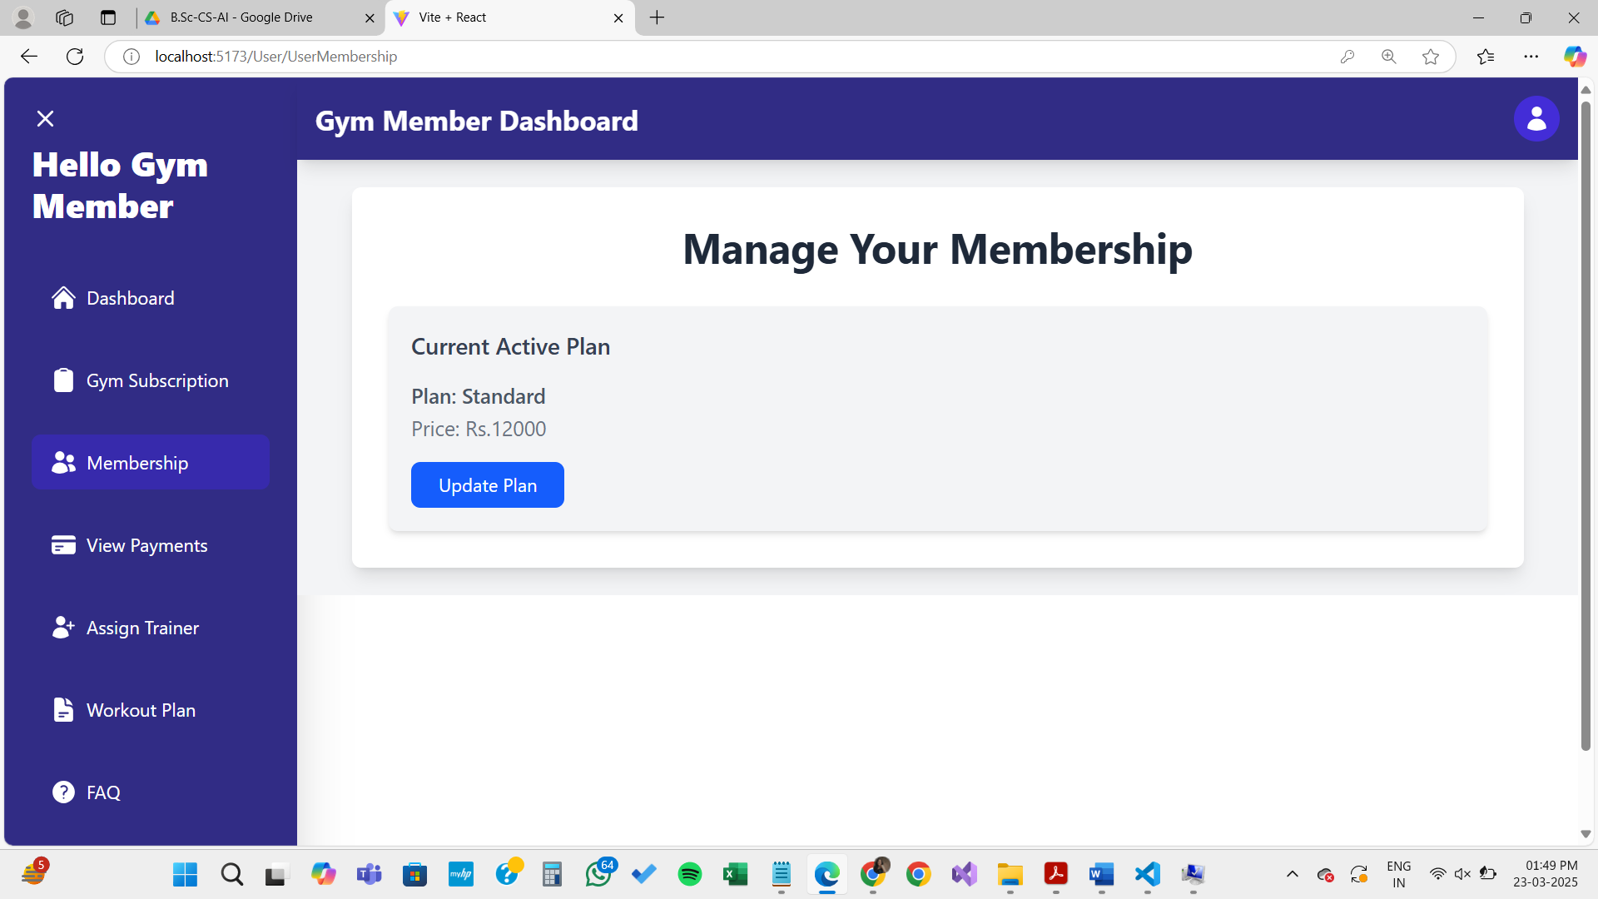

Slide 45
Payments

Slide 46
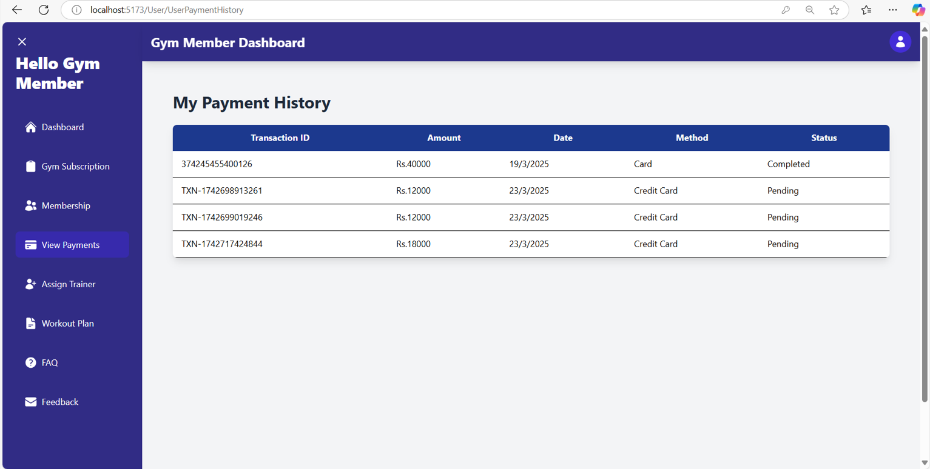

Slide 47
Assign Trainer

Slide 48
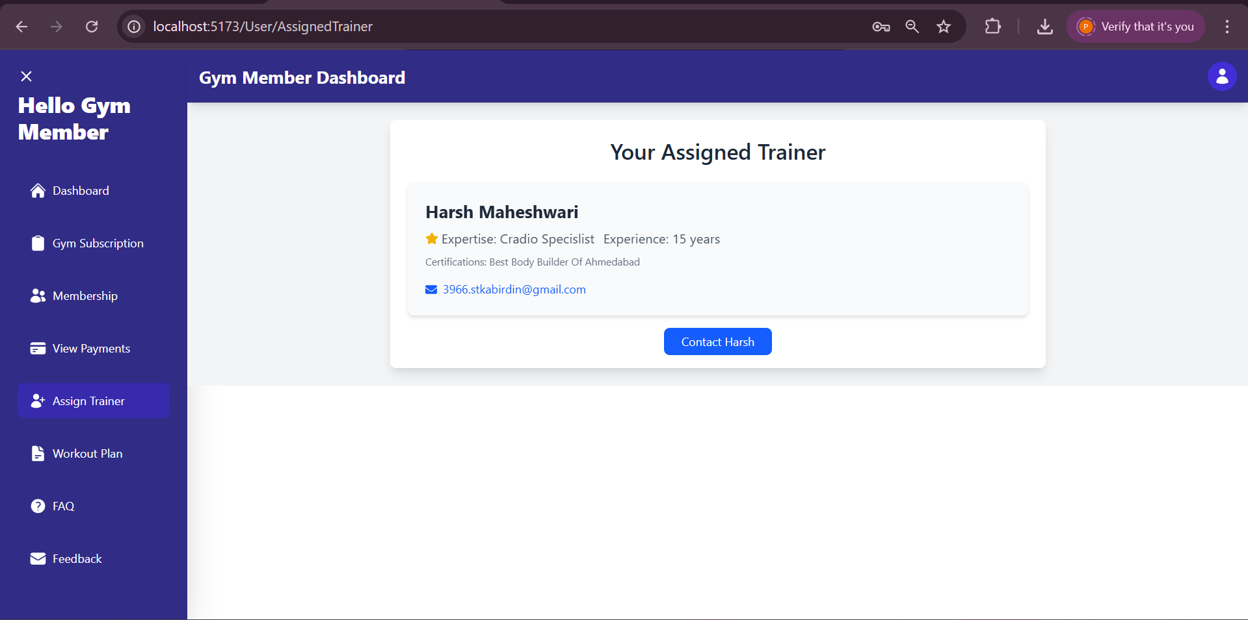
Assign Trainer !!!
Here the member can view a trainer assigned to him/her.

Slide 49
Workout Plan

Slide 50
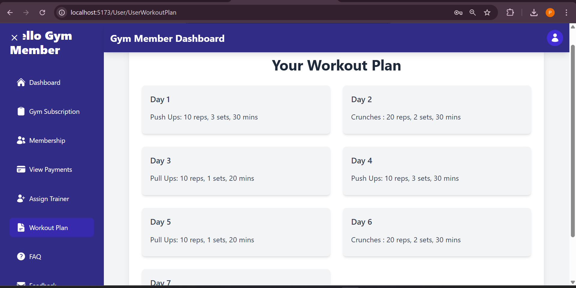
Workout Plan
Member can exercise plans day-wise!!

Slide 51
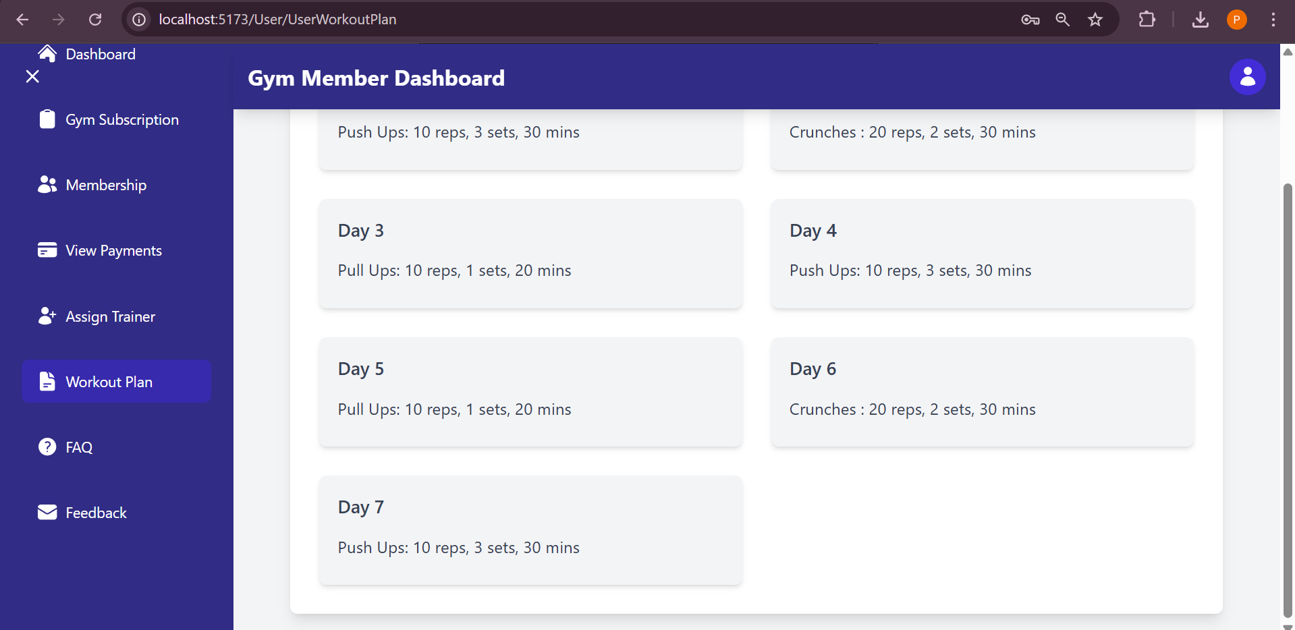

Slide 52
Frequently Asked Questions

Slide 53
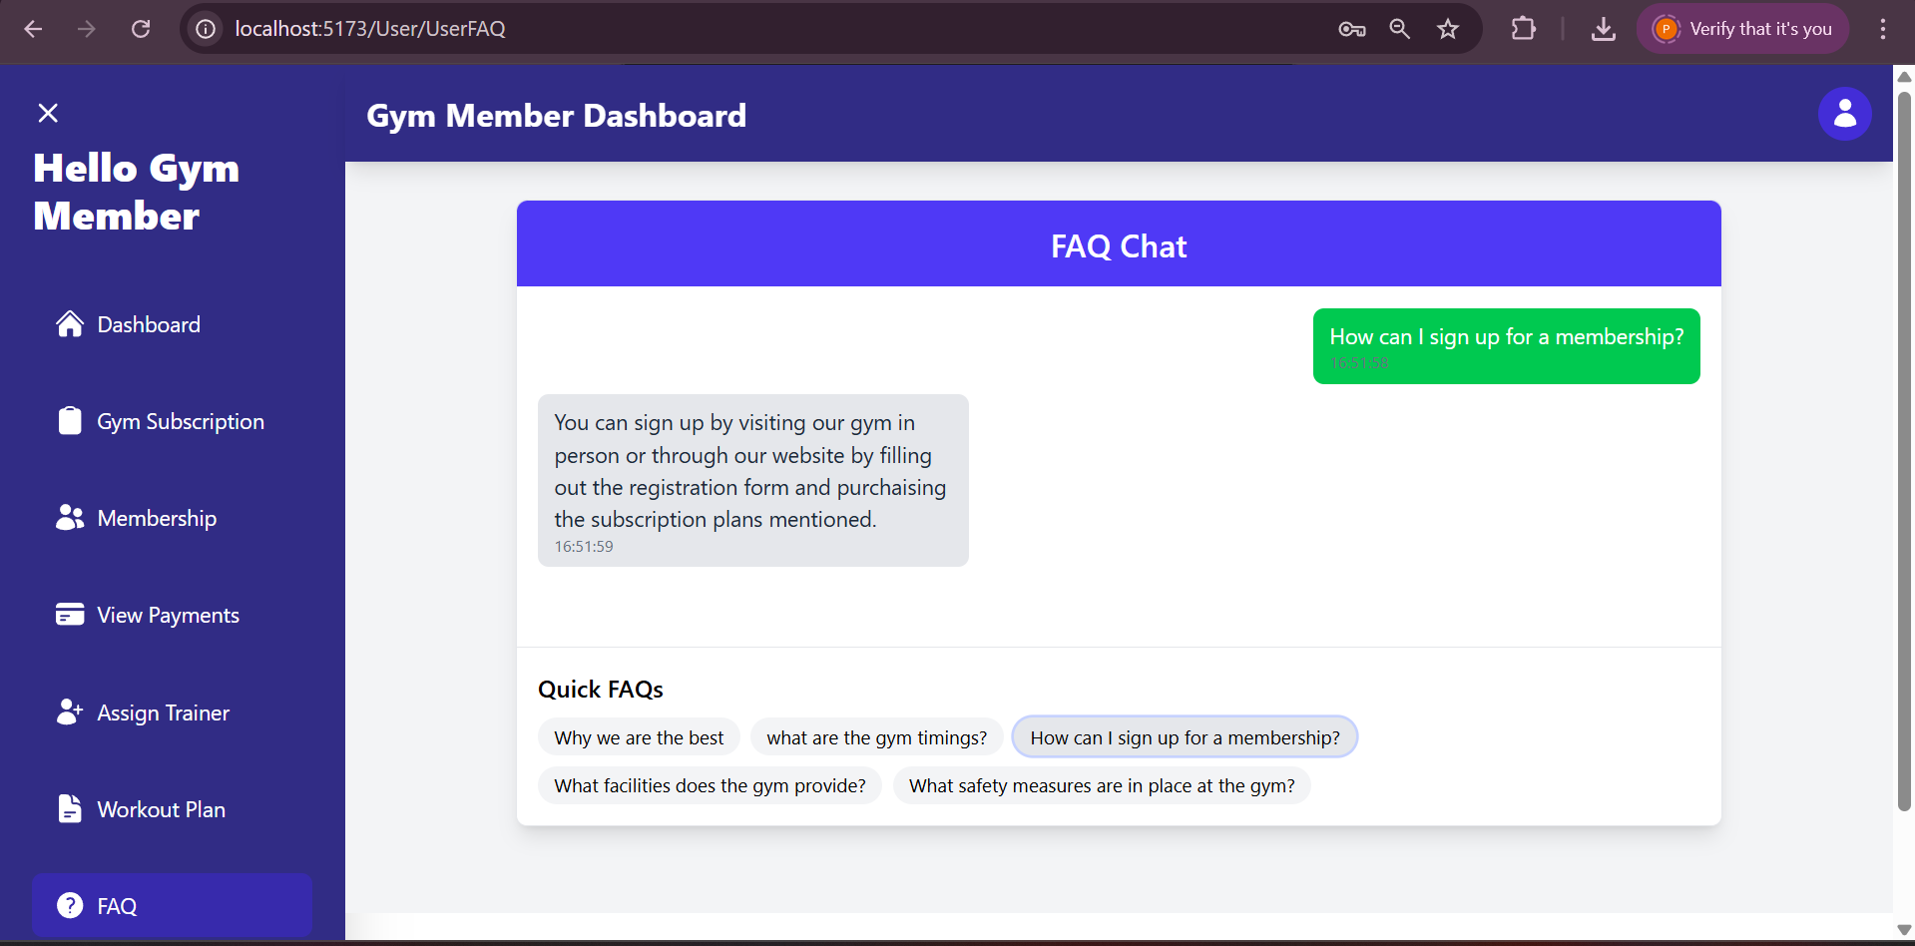
FAQ
Member can ask general questions from a set of predefined questions .

Slide 54
Member Feedback

Slide 55
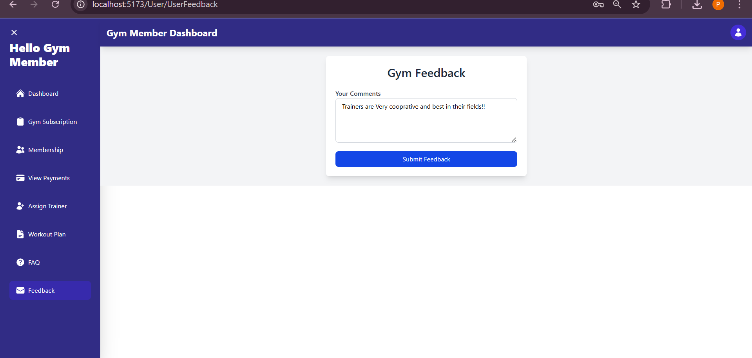
Member Feedback
Member can provide his/her feedback on gym .

Slide 56
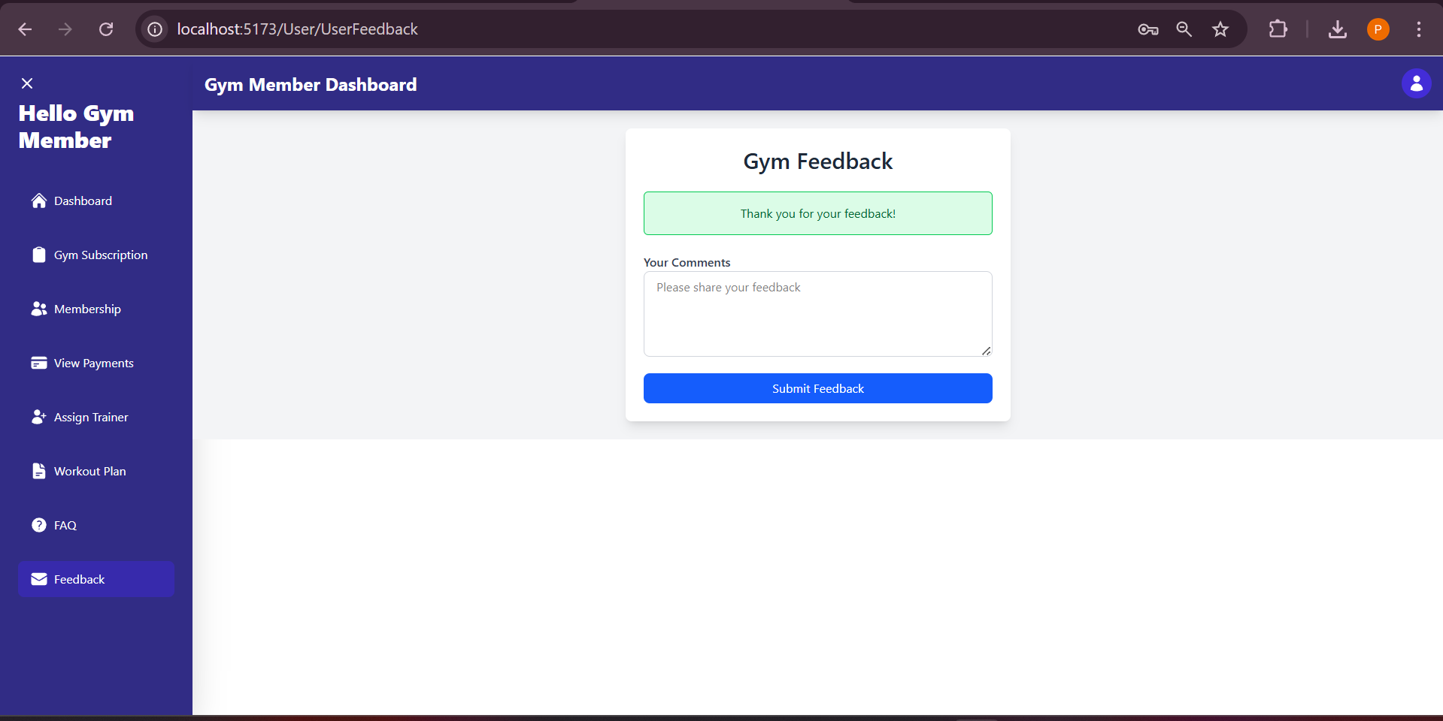

Slide 57
Member logout

Slide 59
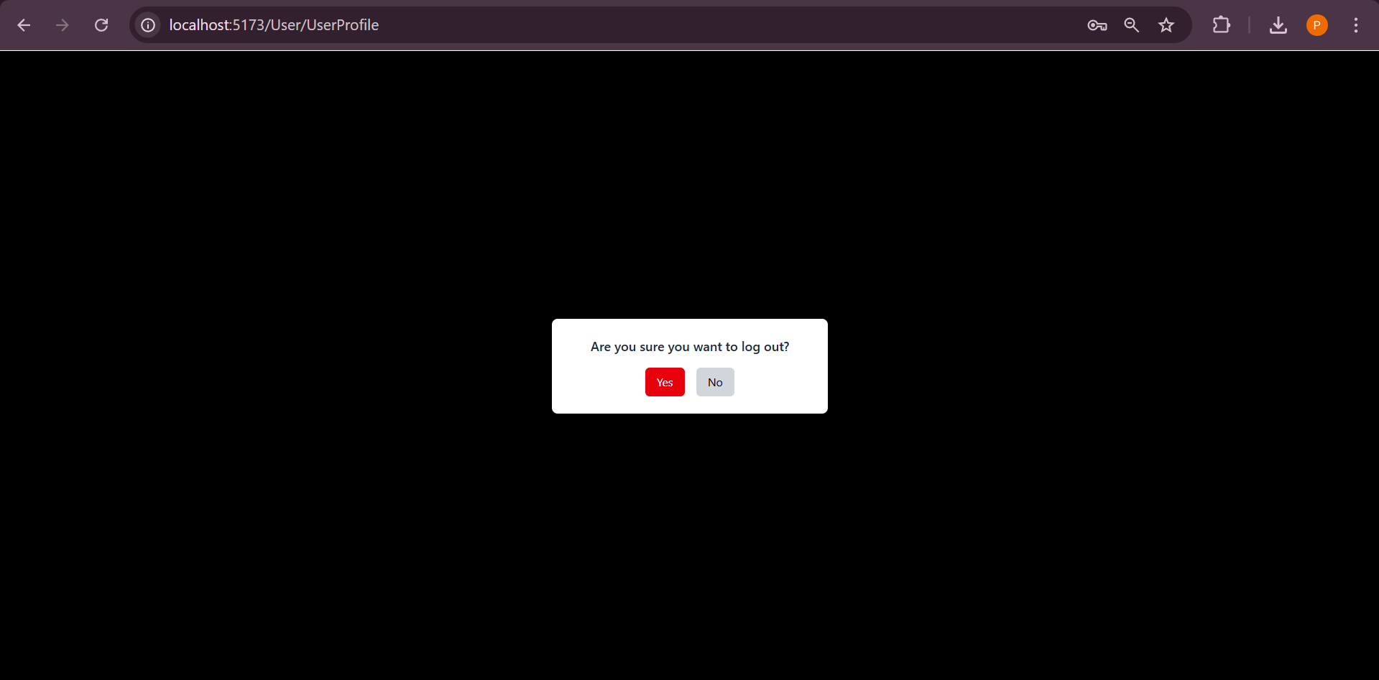
Member Logout

Slide 60
Trainer Panel

Slide 61
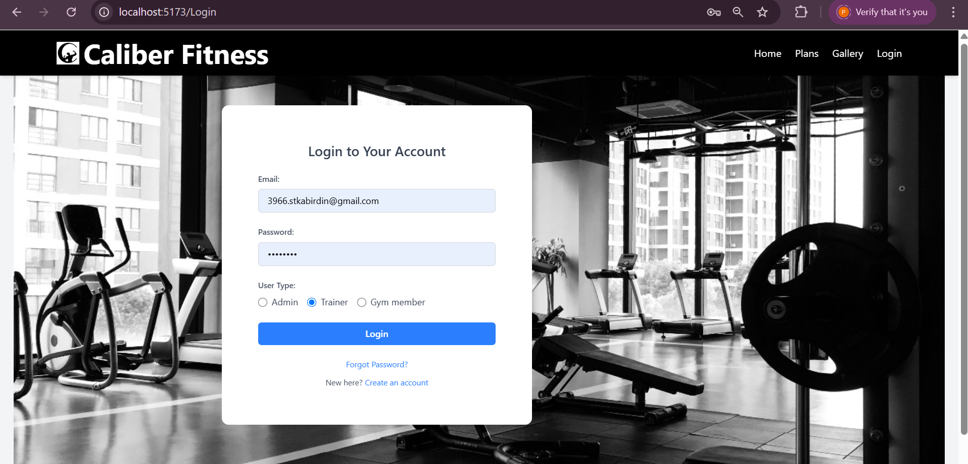

Slide 62
Trainer Dashboard

Slide 63
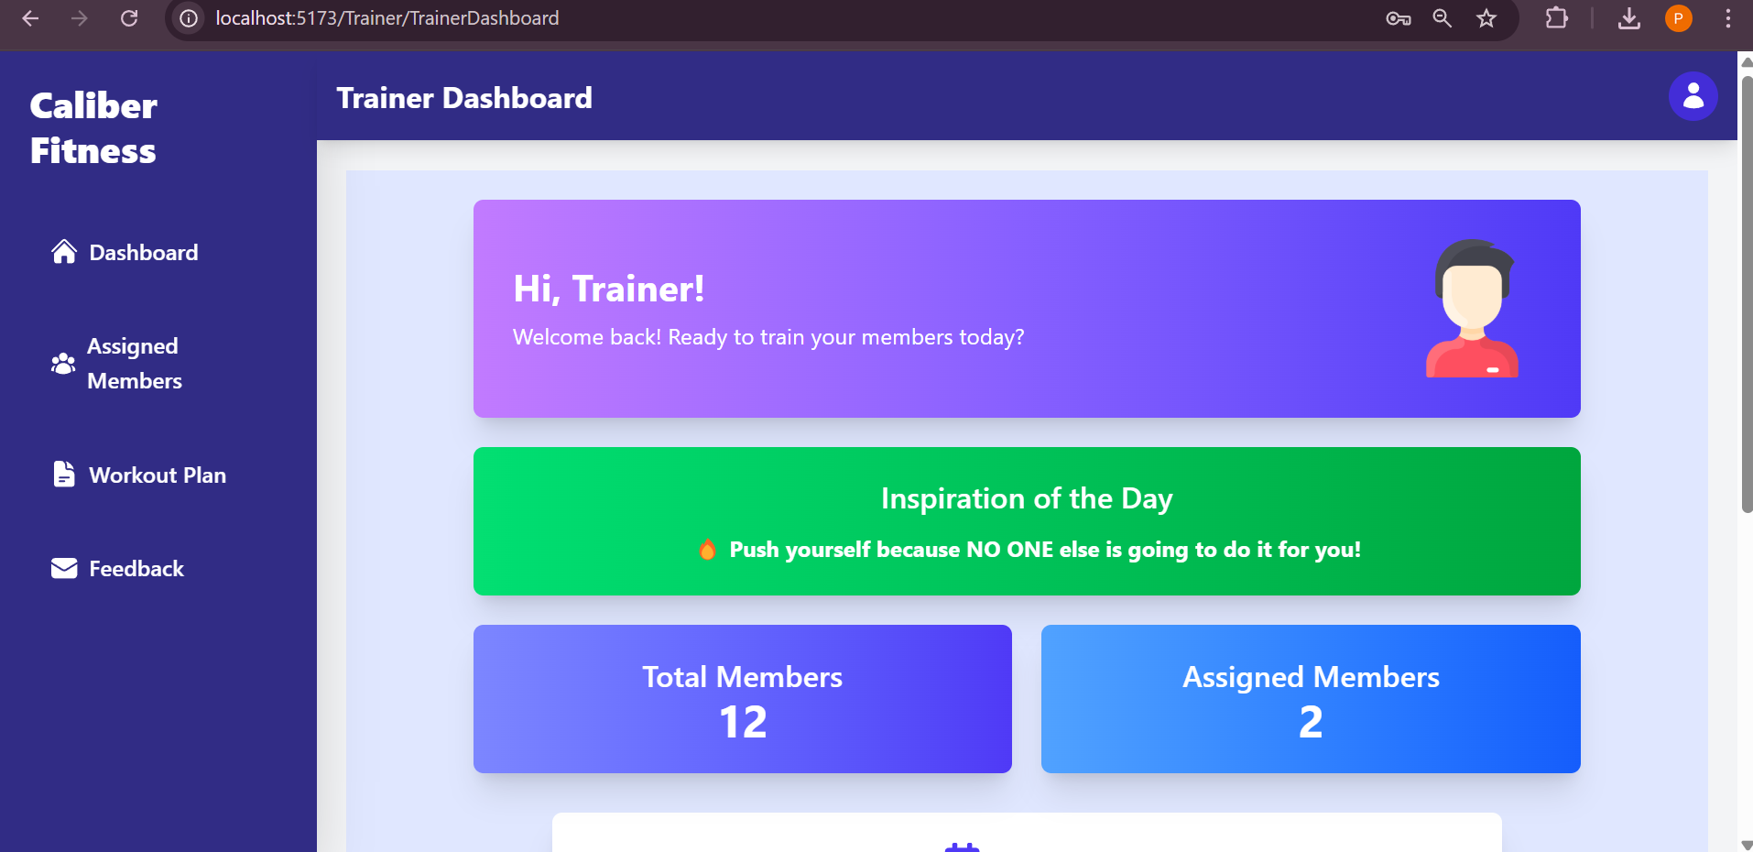
Trainer Dashboard
From here the Trainer can view total member and operates other functionalities like Profile Workout Plan management and can view feedback .

Slide 64
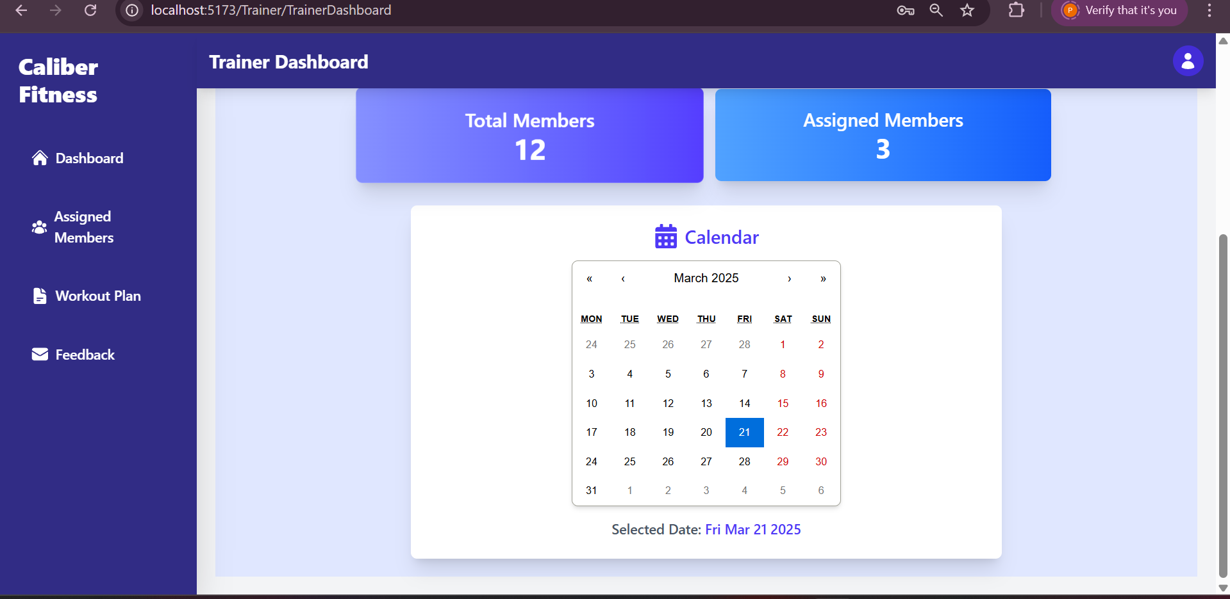

Slide 65
Trainer Profile

Slide 66
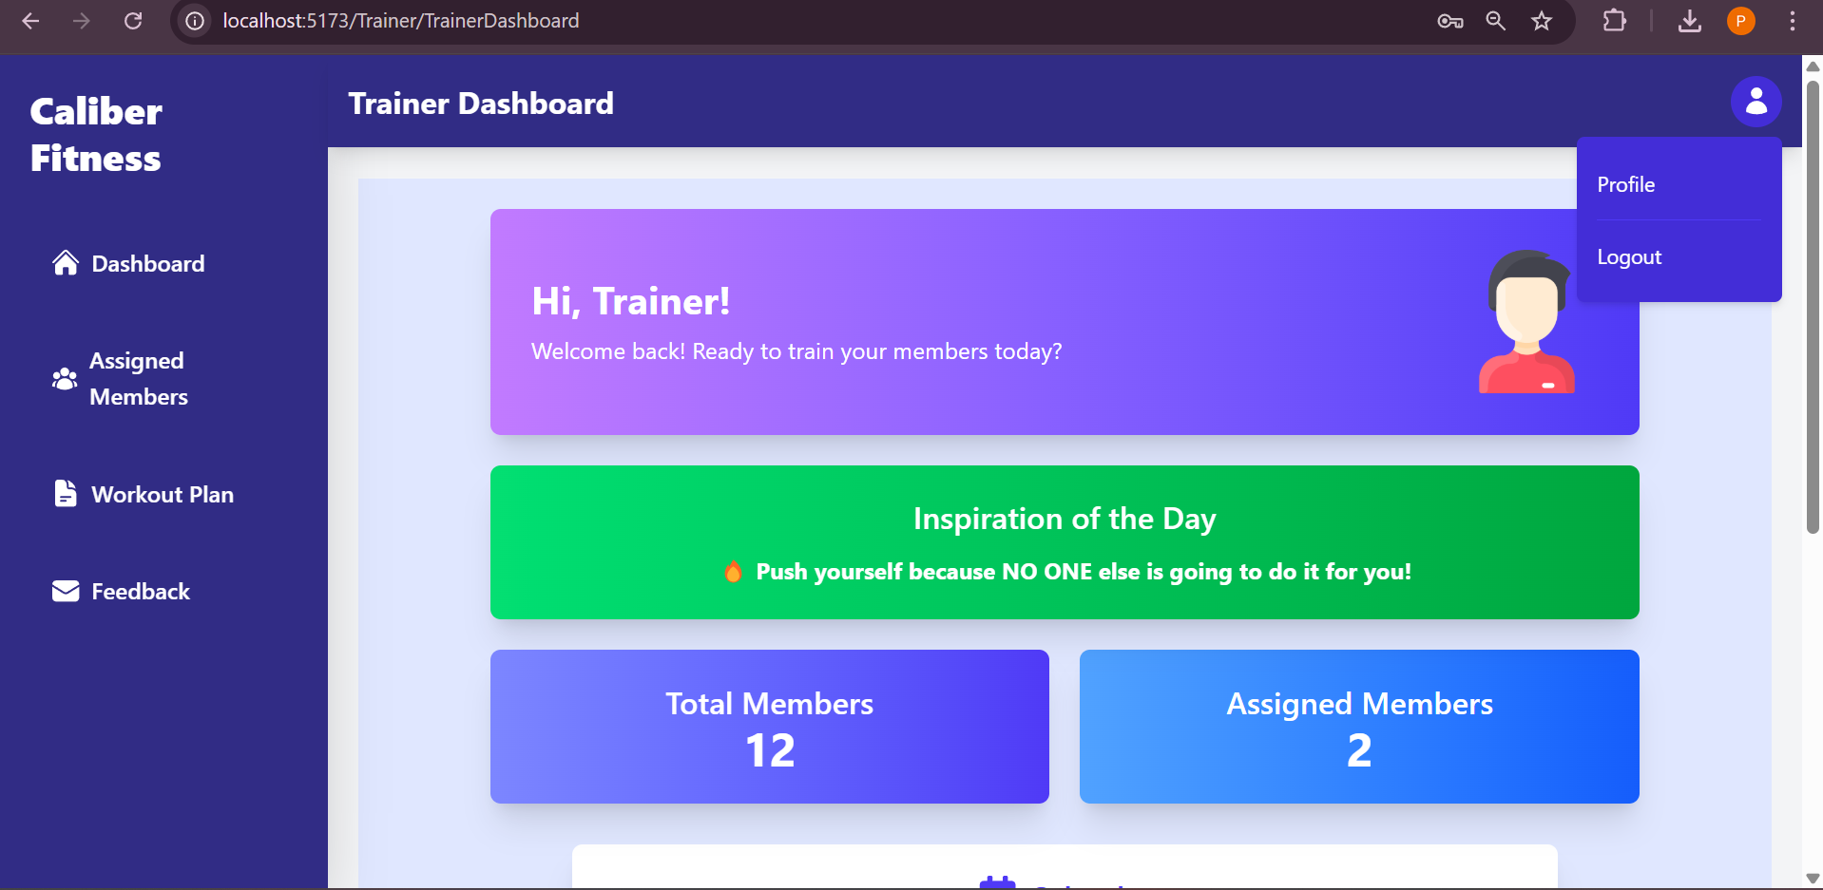

Slide 67
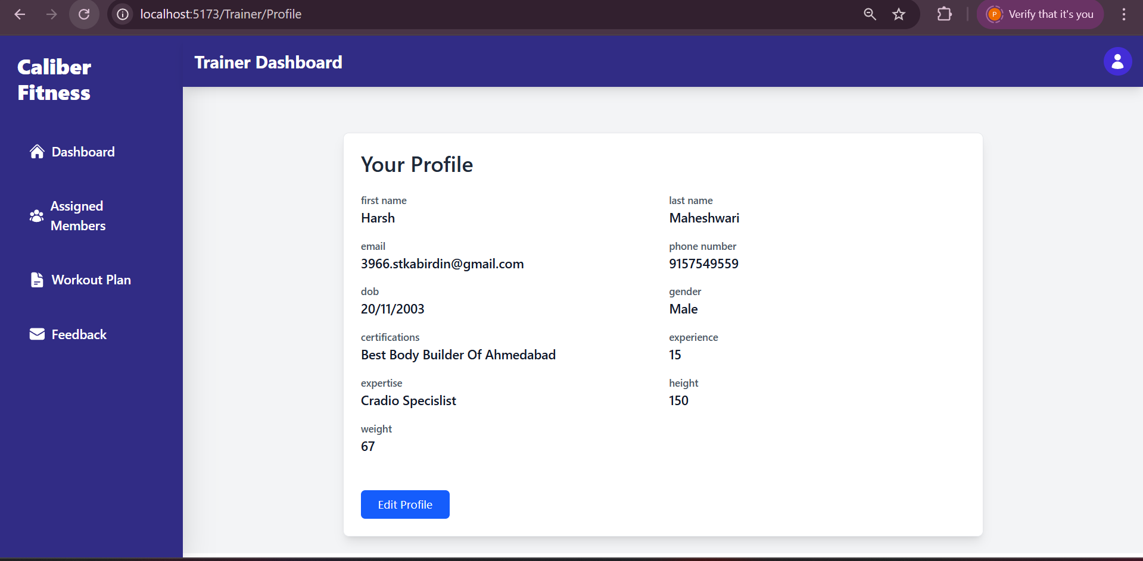
Trainer Profile
Trainer can edit his/her profile .

Slide 68
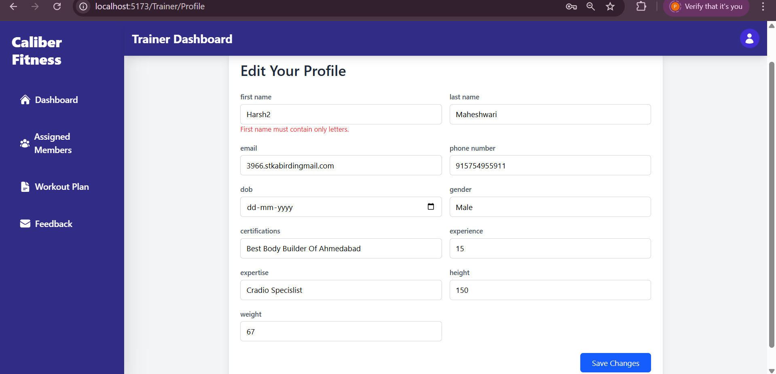

Slide 69
Assigned Members

Slide 70
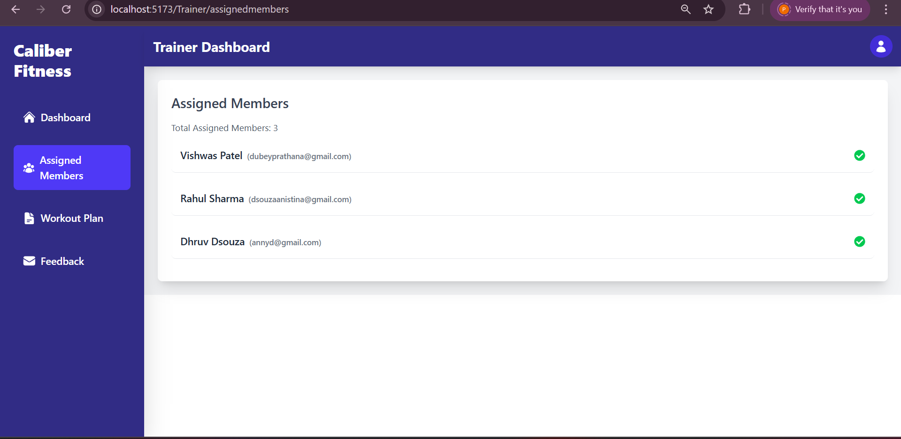
Assigned Members

Slide 71
Workout plan

Slide 72
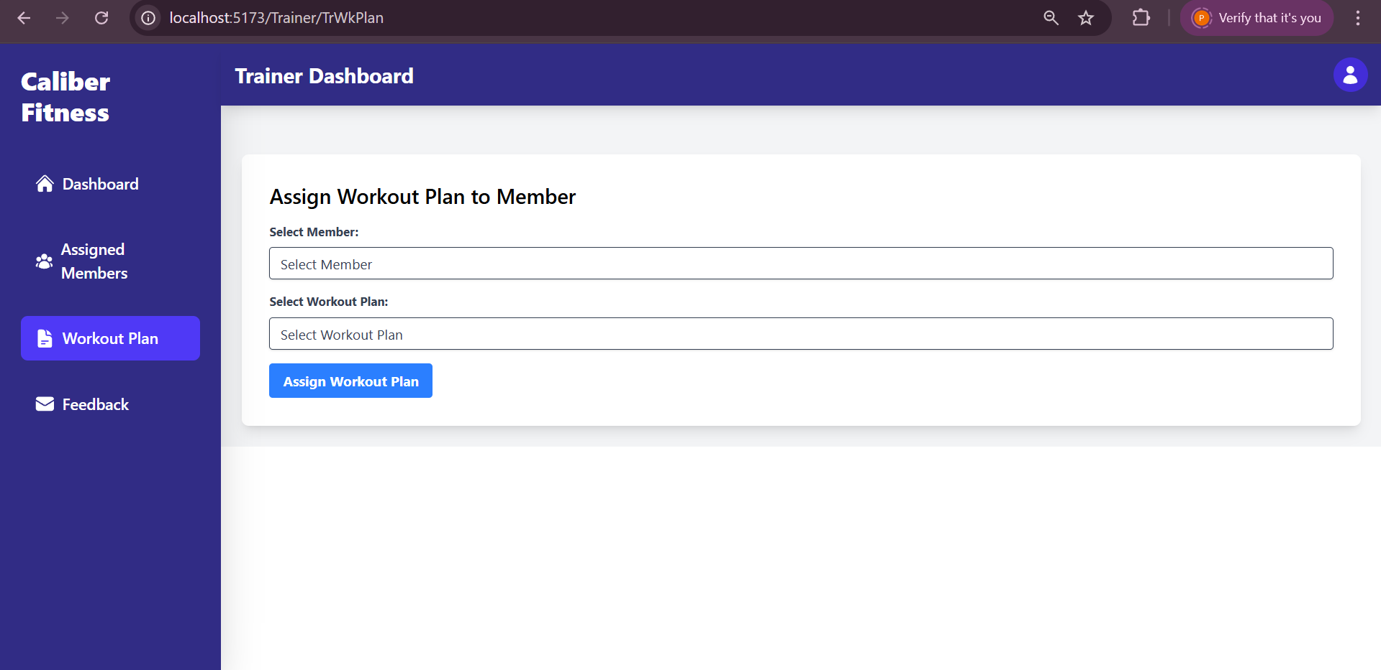
Workout Plan
Trainer can edit the workout plan .

Slide 73
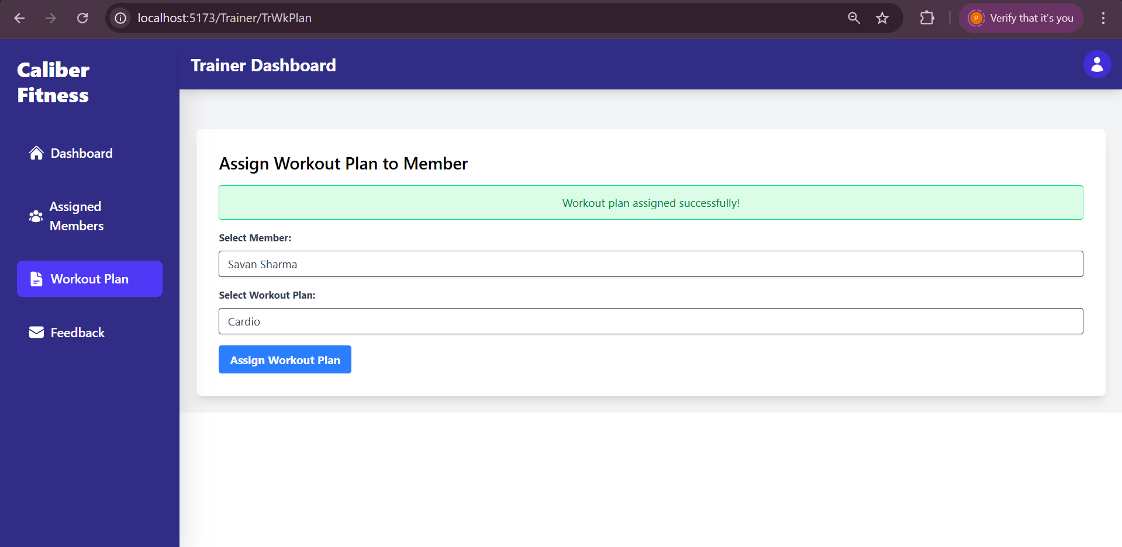

Slide 74
Feedback

Slide 75
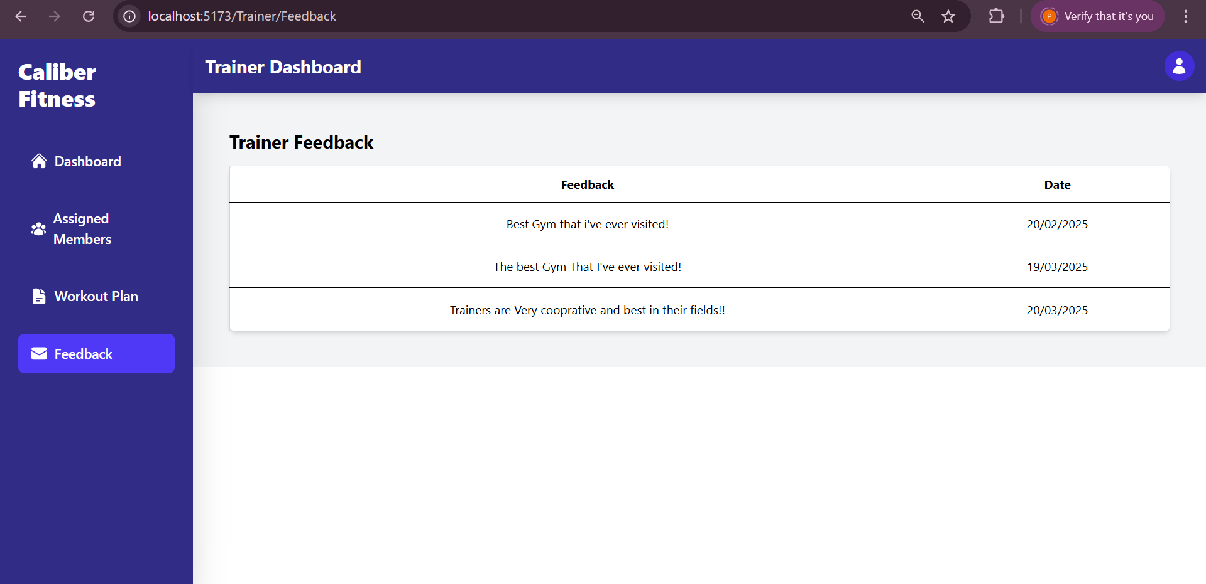
Feedback
Trainer can view the Feedback given by a member .

Slide 76
Trainer Logout

Slide 78
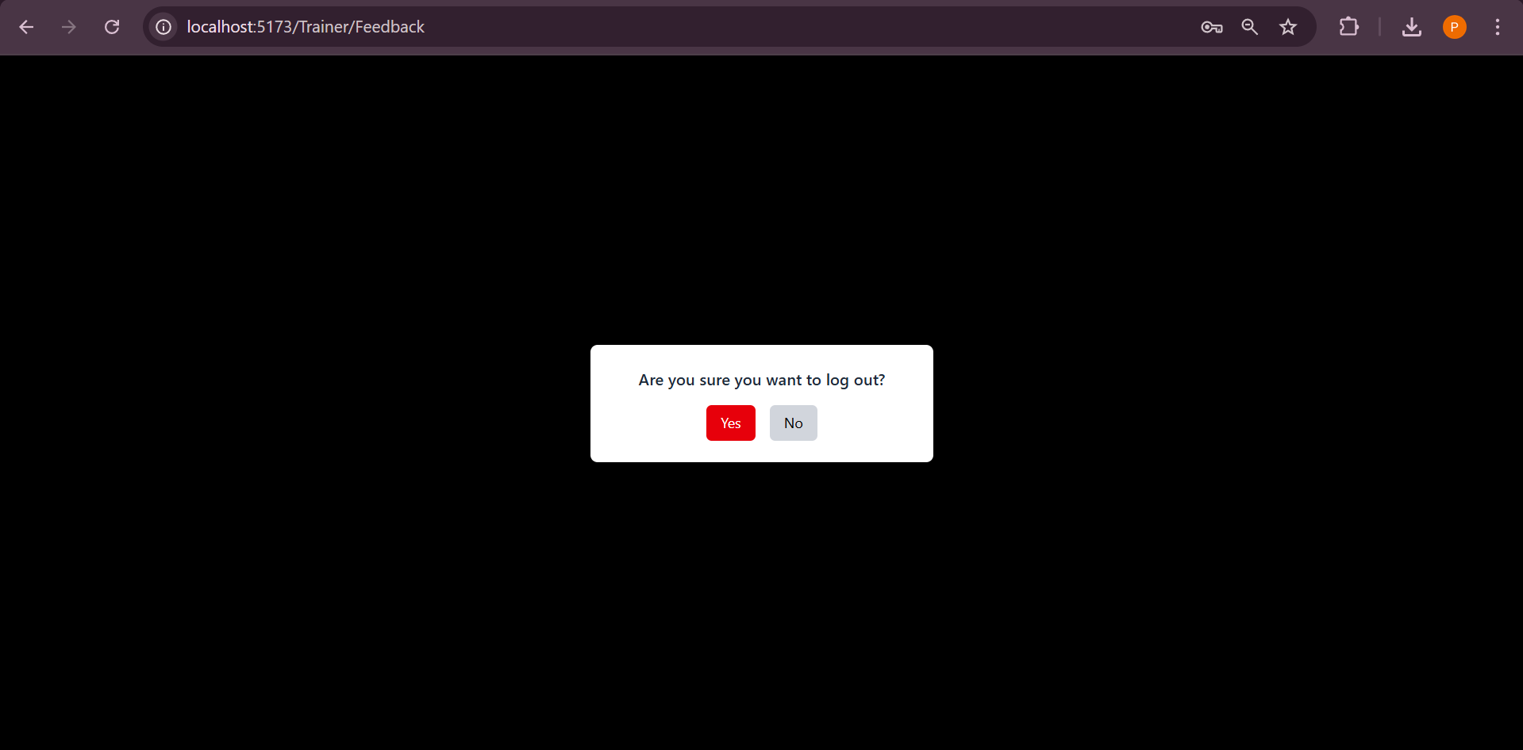
Logout

Slide 79
Admin Panel

Slide 80


Slide 81
Admin Dashboard

Slide 82
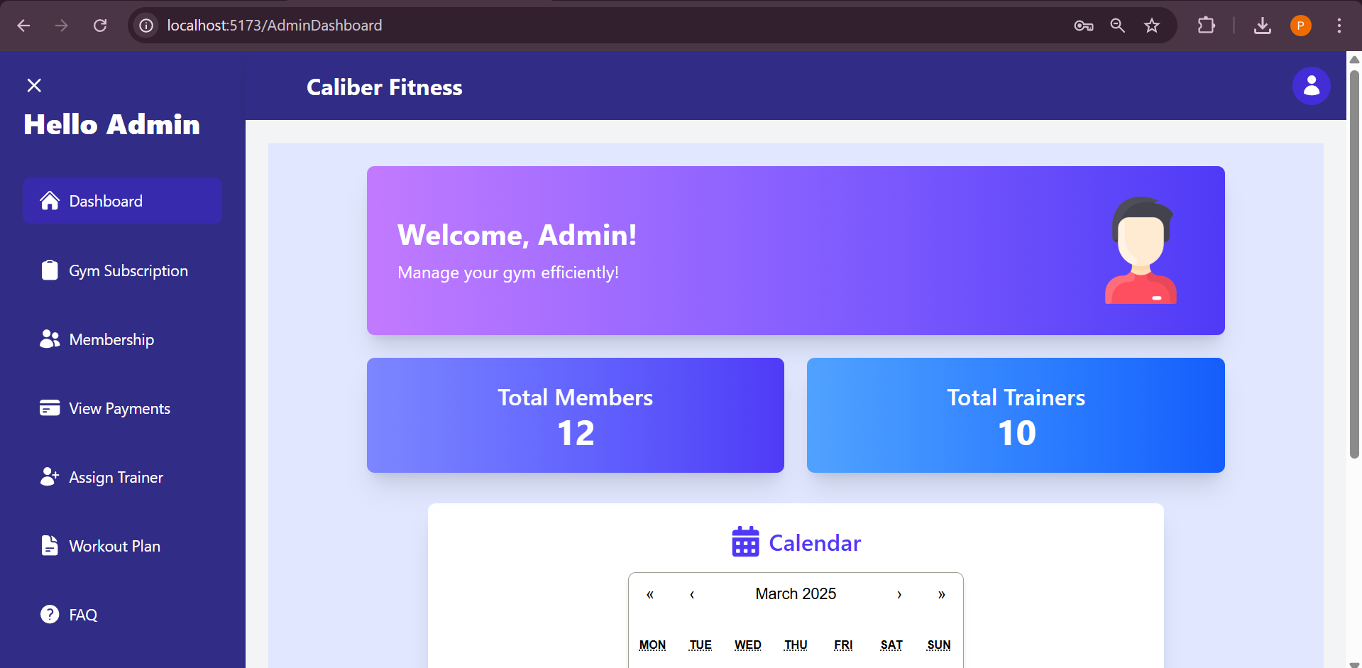
Admin Dashboard
.

Slide 83
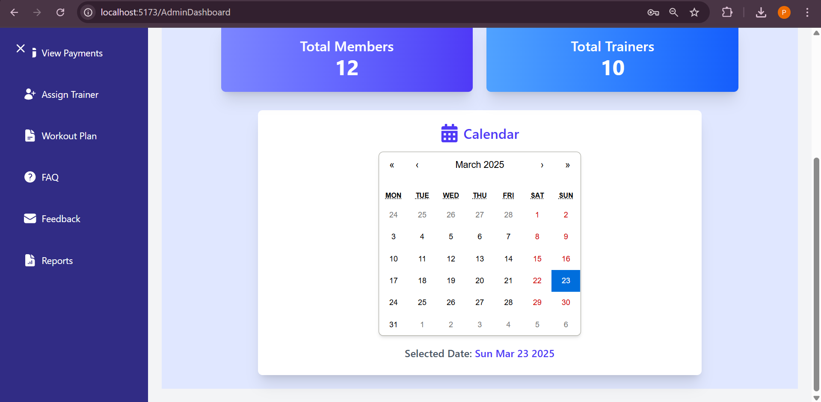

Slide 84
Subscription

Slide 85
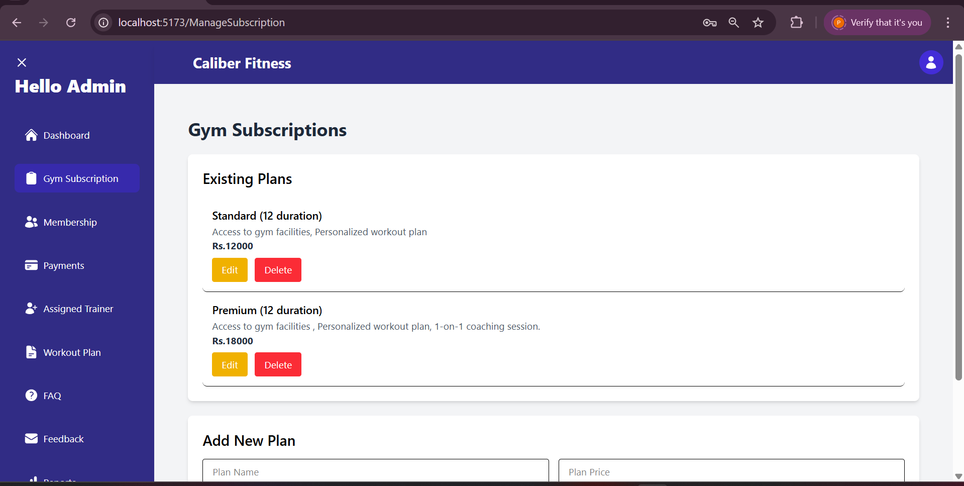
Manage Subscription of Gym
Admin can edit and update the subscription plans for the gym .

Slide 86
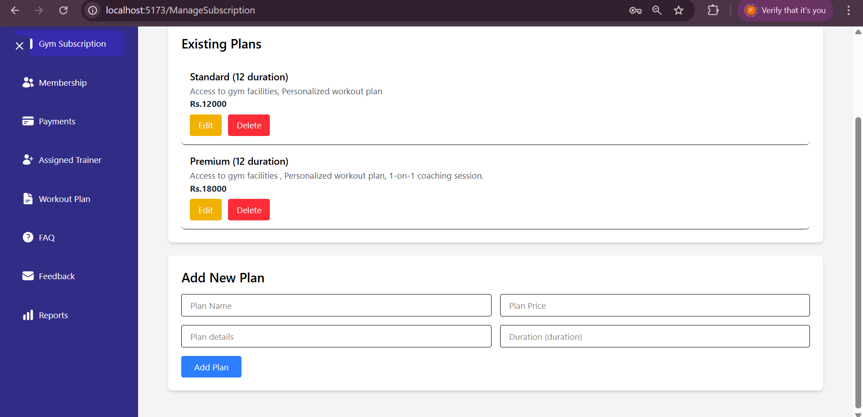

Slide 87

Adding a new Plan .

Slide 88

New Plan added Successfully!!
The plan can be edited and deleted as per the need of GYM.

Slide 89

Edit the existing plan if needed.

Slide 90

Delete the existing plan if needed.

Slide 91
Memberships

Slide 92

Manage Membership of the member
Admin can edit and delete the membership for the gym member .

Slide 93

Edit the Membership of a member if there’s a requirement.

Slide 94


Slide 95
Payment History

Slide 96

View Payment
Admin can view payment detail of the members .

Slide 97


Slide 98
Assign Trainer to Member

Slide 99

Assign Trainer
Admin can assign Gym trainer to the Gym member .

Slide 100

Assigning a Trainer to the Member.

Slide 101


Slide 102


Slide 103
Workout Plan & Exercises

Slide 104

Workout Plan Management
Admin can manage the Workout plan of the gym .

Slide 105


Slide 106


Slide 107


Slide 108


Workout Plans can be edited and deleted using these buttons mentioned.

Slide 109
Frequently Asked Questions

Slide 110

Manage FAQ
Admin can add and delete FAQ as per the requirements of the Gym.

Slide 111


Slide 112

FAQ can be edited and deleted using these buttons mentioned.

Slide 113
Feedback

Slide 114

Feedback
Admin can view and delete the member’s feedback.

Slide 115
Reports

Slide 116

Reports
Admin can generate reports for Membeships , trainers,users ,payments for better future enhancements and use.

Slide 117

Membership report

Slide 118


Slide 119


Slide 120


Slide 121

Members report

Slide 122


Slide 123


Slide 124


Slide 125

Trainer report

Slide 126


Slide 127



Slide 128


Slide 129

Payment report

Slide 130


Slide 131


Slide 132


Slide 133
Admin Logout

Slide 134


Slide 135


Slide 136
Bibliography
Books
Magnifying Object-Oriented Analysis and Design
Publisher: Cengage Learning
By: Gary B. Shelly, Thomas J. Cashman, and Harry J. Rosenblatt
System and Analysis Design
Publisher: Cengage Learning
By: Gary B. Shelly, Thomas J. Cashman, and Harry J. Rosenblatt
WEBSITES:
https://www.draw.io
https://reactjs.org/ ReactJS Official Docs
https://nodejs.org/ Node.js Official Docs
https://www.mongodb.com/docs/ MongoDB Documentation

Slide 137

Thank You!!!

